Slide 1
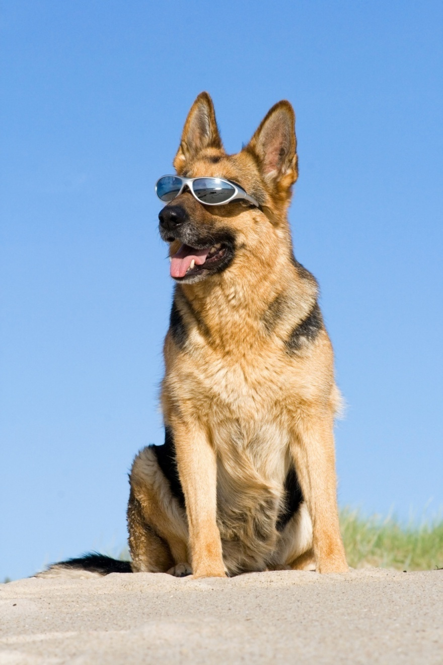
Heat and Hydration

Slide 2
Saving Your K9’s Life
PREVENTTION
HEAT STROKE Leading Cause of Preventable Death
50% Mortality Rate
~~~~~~~~~~~~~~~~~~~~~~~~~~~~~~~~~~~~~~~~~~~~~~~
PREVENTION is How you Win this Game

Slide 3
Overview: Beating the Heat
PREVENTTION
Understanding Heat Injuries
Life-Style Prevention: ABCs of Heat Safety
Effective Breaks
Continuum of Heat Injuries
Heat Code Treatment

Slide 4
Understanding Heat Injuries

Slide 5
Wide variety of risks
Types: Examples
Exertional (EHI):
Activity: Fast/short apprehension, long/slow track
Stress: Dogs that spin themselves into heat stroke
Situational:
Most often Vehicle
Onset:
Sometimes fast: 30 min
Sometimes longer: Hrs after shift
Notes:
Arena example, is Labrador in the south sweeping an arena 85F in GA that needed emergency cooling within 30 min of starting to work. That dog did fine as they recognized early and got them into the stadium showers with cold water and then to the vet quickly.
Also seen dogs go down literally while on their way to point last seen, not even in drive. That was also 30 min and that dog ended up coming back to base in a helicopter while they did CPR. Not good. Fatality. Stress example:
- An MWD that was being transported via air. That dog was transferred to the hangar area, but was so stressed that it literally spun itself into a heat stroke. Eventually euthanized a week later due to permanent brain damage.
- A K9 that had an outdoor kennel and a new when a family dog was introduced to the back yard in a separate kennel, it stress spun itself into a heat stroke as well.

Slide 6
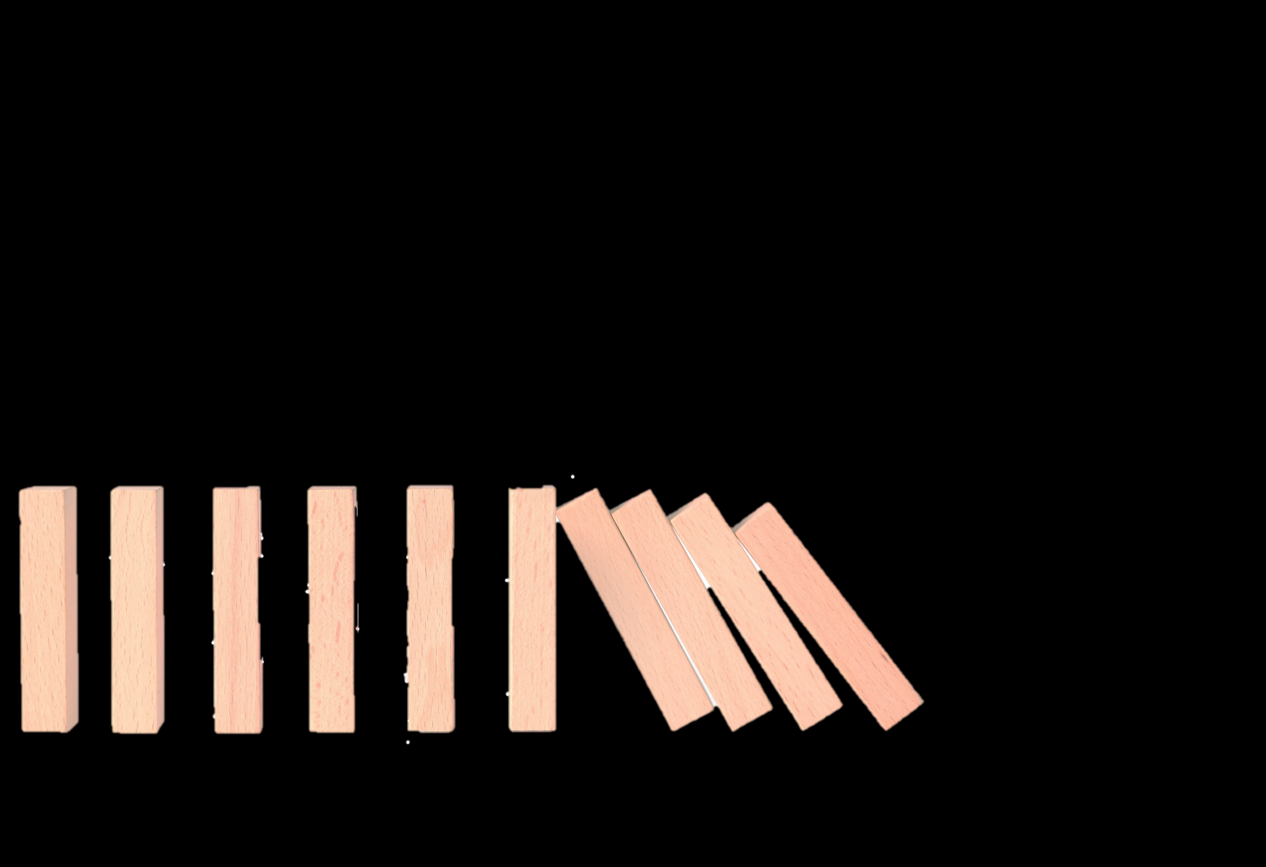
What Happens?
Nervous
Gastrointestinal
Multi-System Failure Requiring ADVANCED 24HR Veterinary Care
Liver and Kidneys
Blood Clotting
Heart & Circulation
Notes:
So, it’s important to understand that what happens to a K9 is a multi-system failure.
Once a dog hits a certain temp, and it’s different with each K9 (see baseline card), a domino effect, or a cascade, of problems is initiated.
Once those dominoes are falling, a veterinarian is required to identify and fix those issues.
(note the order of the errors is not intended to suggest a sequence, just that those are some of the systems affected)

Slide 7
What Happens? Why is this so difficult to recognize/predict?
Damage continues even after patient is cooled
Symptoms may not appear for min or hrs or days
What you can see on the outside of the dog is only the Tip of the Iceburg of the problems inside
… and …
Notes:
What makes this particularly confusing/difficult is that
Damage continues even after the patient is cooled AND
Symptoms may not appear for mins or hrs or possibly days.
So (and I usually demonstrate with Hilde lying down sheperd), when I’m looking the dog,
What I can see on the outside is only the TIP of the iceburg (pause for dramatic effect lol)
And…
It’s going to get worse before it get’s better.
Temperature has momentum:
When you run the Baseline vitals cards with your K9s (or the Handlers K9s if you are a medic),
You see that when the dog exercises, temp goes up… makes sense
Dog works more, temp goes up.
But often, when I initially break my dog, the temperature actually keeps going up, then plateaus, then goes downs.
Which is why it’s going to get worse before it ‘s get better
Best prognosis: The dogs that do the best, the most likely to live, are the ones that get to the veterinary hospital within 90 min of the first sign. And we’l discuss how it’s often easy to miss the first sign.
Worst prognosis: The dogs that are least likely to survive, present in a coma, but also the dogs that present Hypothermic, too cold, are less likely to survive, that part is our responsibility and we will circle back to that at the end of this lecture.
I repeat those two phases a lot…
The it’s going to get worse part refers

Slide 8
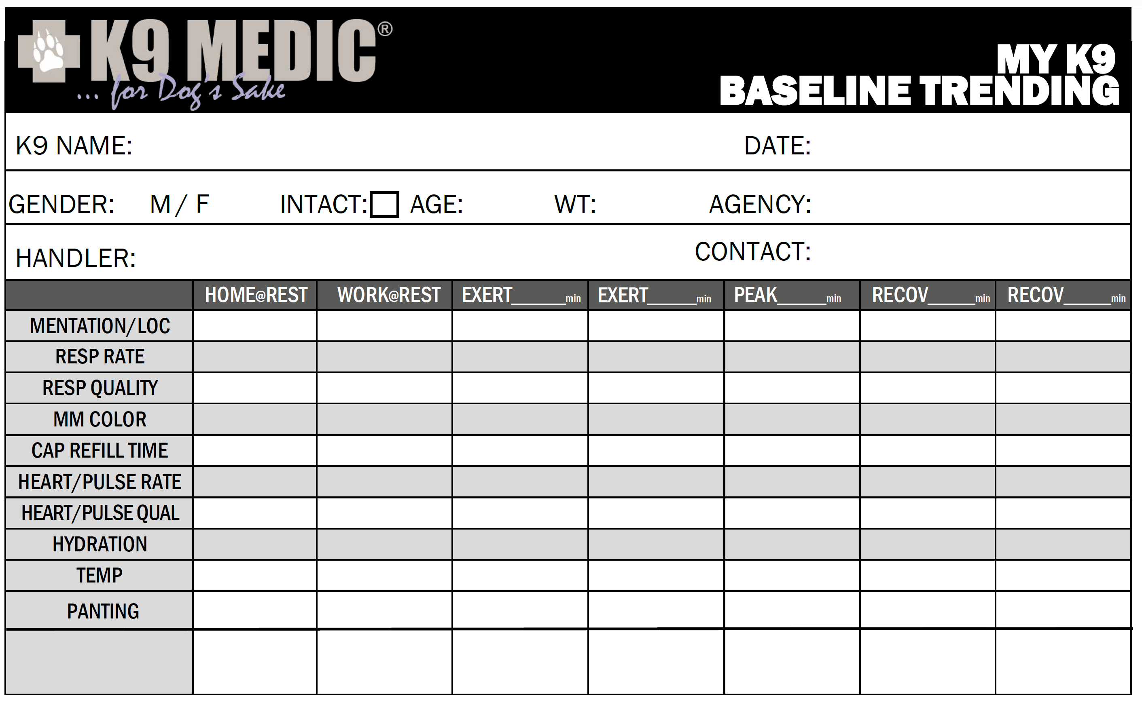
What Happens? Why is this so difficult to recognize/predict?
It’s going to get worse before it gets better…
Temperature Has Momentum!
Notes:
What makes this particularly confusing/difficult is that
Damage continues even after the patient is cooled AND
Symptoms may not appear for mins or hrs or possibly days.
So (and I usually demonstrate with Hilde lying down sheperd), when I’m looking the dog,
What I can see on the outside is only the TIP of the iceburg (pause for dramatic effect lol)
And…
It’s going to get worse before it get’s better.
Temperature has momentum:
When you run the Baseline vitals cards with your K9s (or the Handlers K9s if you are a medic),
You see that when the dog exercises, temp goes up… makes sense
Dog works more, temp goes up.
But often, when I initially break my dog, the temperature actually keeps going up, then plateaus, then goes downs.
Which is why it’s going to get worse before it ‘s get better
Best prognosis: The dogs that do the best, the most likely to live, are the ones that get to the veterinary hospital within 90 min of the first sign. And we’l discuss how it’s often easy to miss the first sign.
Worst prognosis: The dogs that are least likely to survive, present in a coma, but also the dogs that present Hypothermic, too cold, are less likely to survive, that part is our responsibility and we will circle back to that at the end of this lecture.
I repeat those two phases a lot…
The it’s going to get worse part refers

Slide 9
What Happens? Why is this so difficult to recognize/predict?
It’s going to get worse before it gets better…
Temperature Has Momentum!
TEMPERATURE DURING HEAT STROKE: Has massive momentum… like a freight train
MOST VITALS: Plateau and come back to normal quickly
REST
Notes:
What makes this particularly confusing/difficult is that
Damage continues even after the patient is cooled AND
Symptoms may not appear for mins or hrs or possibly days.
So (and I usually demonstrate with Hilde lying down sheperd), when I’m looking the dog,
What I can see on the outside is only the TIP of the iceburg (pause for dramatic effect lol)
And…
It’s going to get worse before it get’s better.
Temperature has momentum:
When you run the Baseline vitals cards with your K9s (or the Handlers K9s if you are a medic),
You see that when the dog exercises, temp goes up… makes sense
Dog works more, temp goes up.
But often, when I initially break my dog, the temperature actually keeps going up, then plateaus, then goes downs.
Which is why it’s going to get worse before it ‘s get better
Best prognosis: The dogs that do the best, the most likely to live, are the ones that get to the veterinary hospital within 90 min of the first sign. And we’l discuss how it’s often easy to miss the first sign.
Worst prognosis: The dogs that are least likely to survive, present in a coma, but also the dogs that present Hypothermic, too cold, are less likely to survive, that part is our responsibility and we will circle back to that at the end of this lecture.
I repeat those two phases a lot…
The it’s going to get worse part refers

Slide 10
What Happens? Why is this so difficult to recognize/predict?
✅Best Prognosis:
Advanced veterinary care within 90 mins from “First Sign”
But First Sign is often hidden/missed
Operational focus is necessarily elsewhere
Dogs in drive may override symptoms
❌Worst Prognosis:
Coma: not good
Hypothermic: too cold!
A dog that gets TOO COLD After they get too hot is LESS LIKELY to survive! And that is something we CAN prevent!
Notes:
What makes this particularly confusing/difficult is that
Damage continues even after the patient is cooled AND
Symptoms may not appear for mins or hrs or possibly days.
So (and I usually demonstrate with Hilde lying down sheperd), when I’m looking the dog,
What I can see on the outside is only the TIP of the iceburg (pause for dramatic effect lol)
And…
It’s going to get worse before it get’s better.
Temperature has momentum:
When you run the Baseline vitals cards with your K9s (or the Handlers K9s if you are a medic),
You see that when the dog exercises, temp goes up… makes sense
Dog works more, temp goes up.
But often, when I initially break my dog, the temperature actually keeps going up, then plateaus, then goes downs.
Which is why it’s going to get worse before it ‘s get better
Best prognosis: The dogs that do the best, the most likely to live, are the ones that get to the veterinary hospital within 90 min of the first sign. And we’l discuss how it’s often easy to miss the first sign.
Worst prognosis: The dogs that are least likely to survive, present in a coma, but also the dogs that present Hypothermic, too cold, are less likely to survive, that part is our responsibility and we will circle back to that at the end of this lecture.
I repeat those two phases a lot…
The it’s going to get worse part refers

Slide 11
Trick Question Raise Hand if Yes
Do Dogs Sweat?
Notes:
Technically, dogs have sweat glands,
But they are receded up beyond their paws.
Some dogs do actually get sweaty paws (and you can see them leave wet paw prints on the pavement)
But even these dogs do not use sweat as a primary means to dissipate heat.

Slide 12
Do Dogs Sweat?
Technically…
YES: Sweat glands in paws
But…
Not effective to dissipate heat
Notes:
Technically, dogs have sweat glands,
But they are receded up beyond their paws.
Some dogs do actually get sweaty paws (and you can see them leave wet paw prints on the pavement)
But even these dogs do not use sweat as a primary means to dissipate heat.
#ReplacePhoto need approved photo

Slide 13
Humans Sweat!
For Humans... Wet + Wind = Cooling
Wet: Skin Surface
Wind: our movement or external circulation
Plus, we lose electrolytes
For Dogs…
Notes:
Comparing humans to dogs
Segue

Slide 14
Panting
When I pant, air moves over my moist tongue, mouth and airway Evaporation cools me down
Wet + Wind = Cooling
Notes:
Dogs are similar, but different.
They also use Wet+Wind=Evaporation.
In their case, the wet surface is
-their tongue
Their mouth
And their airway
And the Wind (click)
Is them panting
That is why as they need to increase their heat dissipation,
they pant faster (more wind)
- there tongue gets longer or wider, (more surface area for the wind to pass over)
And their mouth opens wider to accommodate more wet+wind=cooling

Slide 15
Panting Increases
More “Wet”:
Hyper salivation
More “Wind”:
Tongue gets longer/wider
Mouth opens wider
Rate increases
Notes:
Dogs are similar, but different.
They also use Wet+Wind=Evaporation.
In their case, the wet surface is
-their tongue
Their mouth
And their airway
And the Wind (click)
Is them panting
That is why as they need to increase their heat dissipation,
they pant faster (more wind)
- there tongue gets longer or wider, (more surface area for the wind to pass over)
And their mouth opens wider to accommodate more wet+wind=cooling

Slide 16
Hydration Importance
More significant than “Are You Thirsty? “Are you physiologically capable of cooling yourself?”
Wet + Wind = Cooling
Notes:
SO, when I was swiping [dog name’s] mouther earlier, I wasn’t just asking Hey are you Thirsty
I was actually asking [dog’s name] are you physiologically capable of cooling yourself!!!
BECAUSE, if swipe his cheek and it’s dry or tacky,
Do I have Wet + Wind = Cooling?? NO
I have Dry + Wind = Sucks to Be Me
I have Dry + wind that is not physiologically capable of cooling herself.
So, I know I need to know how to hydrate my dog which we cover during the Effective Breaks section. But first.. Let’s talk about how we can support our dogs not just during their work cycle, but how every day choices can build up a more heat resistant dog overall.

Slide 17
SUMMARY: ABCs of Heat Safety
PREVENTTION
PREVENTTION
Lifestyle choices the support your dog
Assessments: Know Your Dog  Exertion Curve Trending
Body Conditioning: Condition Your Dog  Physical Fitness
Climate Control: Acclimatize Your Dog  Avg Ambient Temp
​

Slide 18
Assessments: Know Your Dog
PREVENTTION
Notes:
At Rest: as unstimulated as possible
Vehicle: Duty Baseline (may be the same as column 1)
Remaining Columns… Exertion Curve
It’s essential to have a vivid database/picture of what each dog looks like as they climb the exertion curve AND as they recover.
(describe in more detail and importance)

Slide 19
Body Conditioning
PREVENTTION
6mi daily run or equivalent is protective
Regular exertion in expected work temp/environment
Notes:
At Rest: as unstimulated as possible
Vehicle: Duty Baseline (may be the same as column 1)
Remaining Columns… Exertion Curve
It’s essential to have a vivid database/picture of what each dog looks like as they climb the exertion curve AND as they recover.
(describe in more detail and importance)

Slide 20
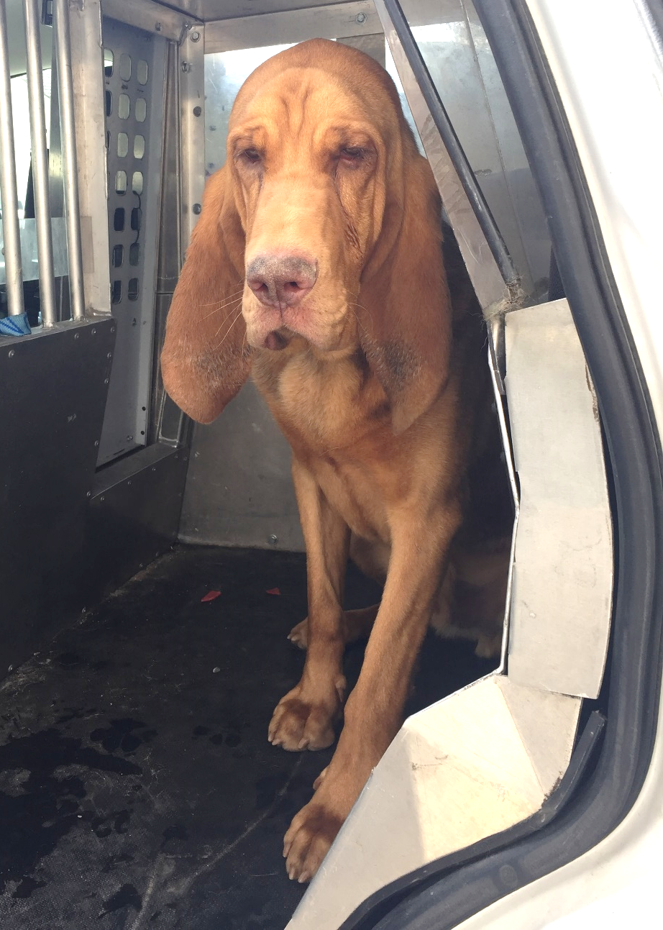
Climate Control
PREVENTTION
Acclimatization
Beneficial physiological adaptations from repeated exposure to higher temp (~2 weeks)
Everyday
Keep kennel/home temps closer to work temps
Consider avg temp 24x7 x 2 weeks
Cooling specifically for support & recovery
Rapid Environmental Changes
Seasonal changes and travel
Ideally start with 25-50% exertion exposure
Notes:
Acclimatization is key to protection:

Slide 21
#EyesOnForSafety
PREVENTTION
Vehicles a leading cause of heat injury
Sometimes left for many hours
Sometimes very short period
Exertion curve  temperature has momentum
Greatest risk after exertion as you leave
Fatalities during 1hr lunch
#EyesOnForSafety
Visual assessment live or camera every 20min
At least until return to baseline
Notes:
Speaking of vehicles…
Another key prevention tool is…

Slide 22
ABCs of Heat Safety
PREVENTTION
Awareness using exertion curves improved Body Conditioning
Climate Control
Increased Safety and Performance
+
+
=
Notes:
THIS i Establish Lower/safer working body temps

Slide 23
Break Early, Break Often
Increases overall speed and performance
Longer and safer work cycles
Consequences of insufficient breaks?
Longer breaks needed to recover (momentum)?
Need to stop the work?
Need to go to ER?
Fatality?
Notes:
When time and tactics allow

Slide 24
🎯Key goals for breaks?
Assess exertion curve
Reduce temperature momentum
Provide cooling and hydration
?

Slide 25
Ongoing Assessments
Notes:
#NoPrint
So first, we need to be aware of where are dog is on their exertion curve
At a minimum, we highlight Panting, Pulse, and Hydration Ideally we have also spent some time temping our dog so we have a best guess and adding cRT is always good too! ☺
This slide automatically animates from the previous slide

Slide 26
Ongoing Assessments
Always check at least…
Notes:
At Rest: as unstimulated as possible
Vehicle: Duty Baseline (may be the same as column 1)
Remaining Columns… Exertion Curve
It’s essential to have a vivid database/picture of what each dog looks like as they climb the exertion curve AND as they recover.
(describe in more detail and importance)

Slide 27
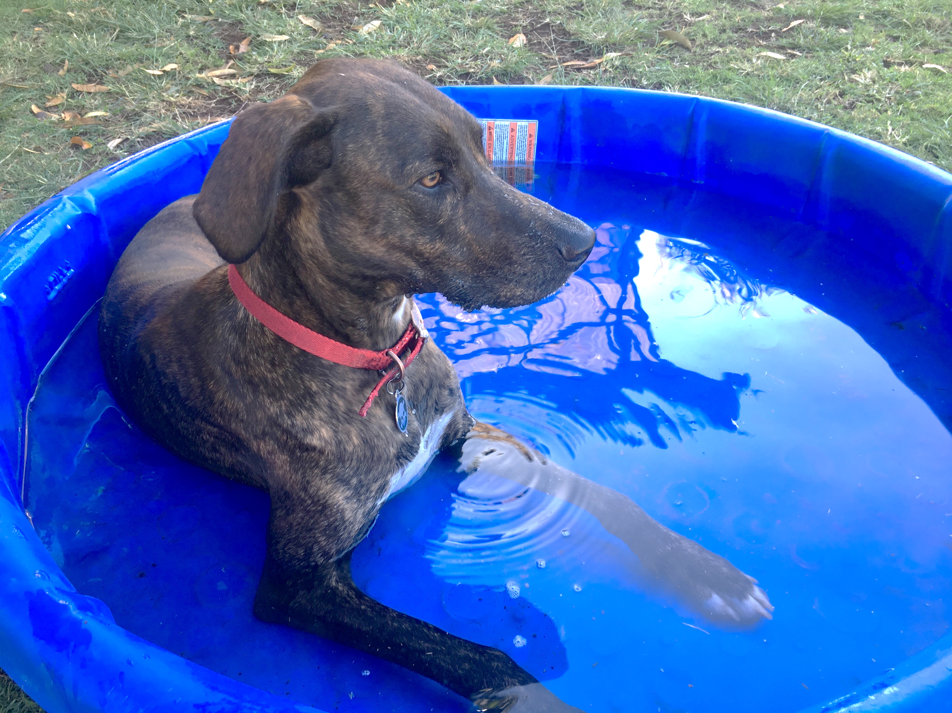
Supportive Cooling Methods
Best Case: Cold Water Immersion (with ice)
Rivers
Troughs
Pools
Body bags
Not always practical, portable
Notes:
Now we get to cooling….

Slide 28
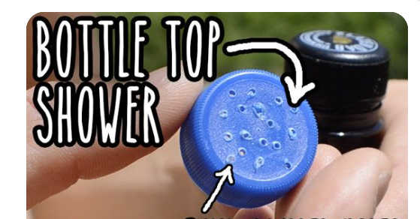
Supportive Cooling Methods
Next Best: Wet+Wind=Cooling
WET Hydration: High quality, frequent drinking water
WET External: See previous + hoses, sprinklers, carried
WIND: AC, Fans, open breezy area
Notes:
And most practical, mobile, so much focus here For hydration, we will talk about that more in just a few slides…
For wet external, many teams start with their dogs fur wet and work hard to keep it wet.
You can consider evaporative vests but once they are dry they do nothing. You need to keep them wet, and the dog’s fur works like a built in vest that you can keep wet!

Slide 29
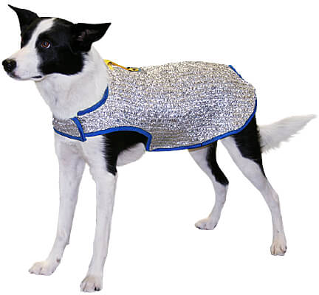
Supportive Cooling Methods
Good Additions:
SHADE: from the environment, reflective vests…
CONTACT: Grass, kennel pads, ice packs/vests, 6” below dirt…
Notes:
Chilly buddy canine cooling jacket: not good for tactical or brushy areas where the threads get caught

Slide 30
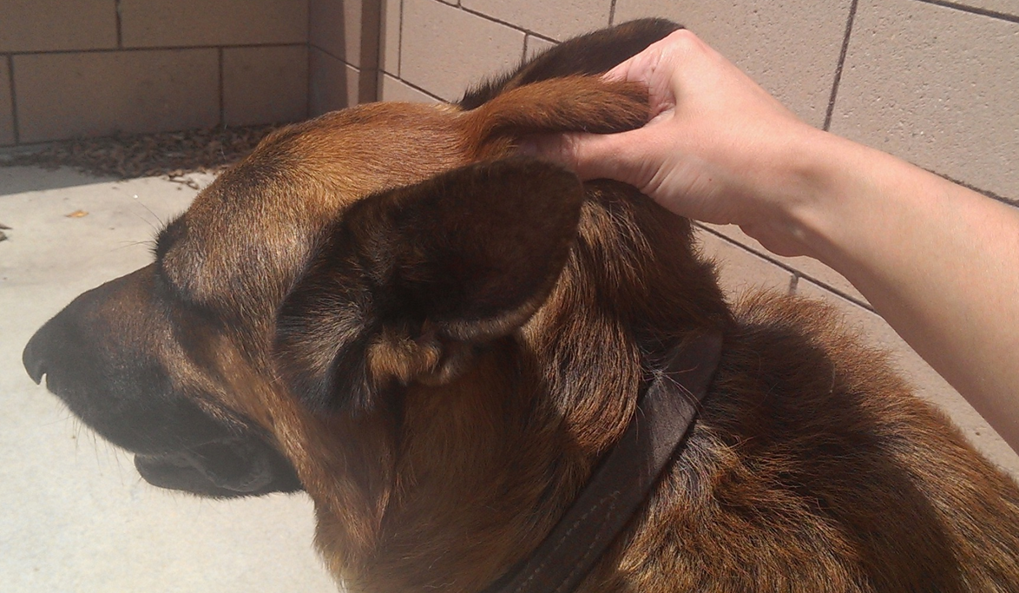
Hydration
“Cheek check”
Normal: moist/wet/juicy
Dehydrated: dry/sticky/tacky
Skin turgor aka “tent test”
Lift and release skin
Normal: snaps into place
Dehydrated: slow to return
Urine (sometimes)
Dehydrated: low volume, dark and strong odor
Notes:
In addition to direct temperature, assessing hydration is another way to prevent heat injuries. If safe, feel inside the lips of your K9. It should be adequately moist. If it feels sticky or tacky, then your K9 is dehydrated and needs more fluids. Another way to assess hydration is using “skin turgor” aka the “tent test”. Pinch and lift the skin in a place where it is loose, but is not too thick. The base of the head, neck and/or shoulder blades are good candidate locations. In a well-hydrated dog the skin will snap back into place. If the dog is dehydrated, it will be slower to return back to place. This is such a simple and significant test that on long, hot missions, we do this every 20min and increase fluids as required. Mouth Swipe:
Probably the most important field vitals.
We check every 15-20 minutes (or more often in unforgiving situations).
Turgor:
This is a Late Sign for field purposes.
Missed multiple mouth swips if this is anything other than instant
The test on the back, is the ‘back-up’ test.
But still do every 15-20 minutes.
Not too close to collar, because the collar may interfere with the speed of the skin response.

Slide 31
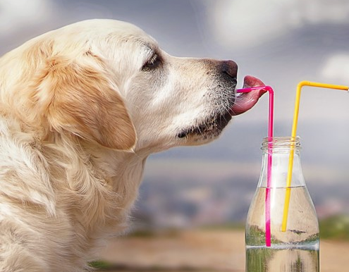
Hydration
Palatability
Clean
Cold (if possible)
Consider (safe) FLAVORING!!
Hydration logistics
Quantity
Transportation
Drinking Containers
Notes:
Committing to keeping them well hydrated ALL the time all day every day!
Remember?
importance of panting from before
how to monitor hydration from assessments
Hydration enables effective panting and thus cooling
Containers:
Storage and Transportation (water bottles, jugs, 5Gal for car etc
For drinking (bowls, cups, camelbacks for trails etc)
Compare to chronic human dehydration

Slide 32
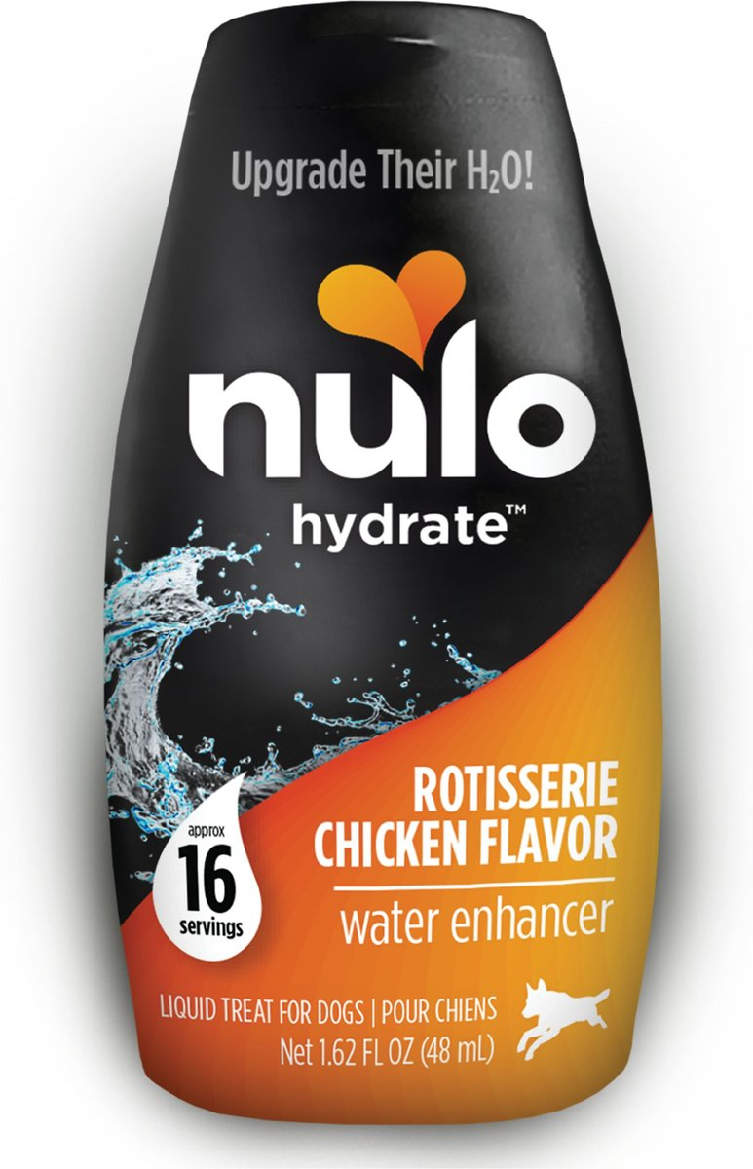
Flavor
Add product only to flavor
If ‘electrolyte replacement’ don’t use full strength
No electrolyte loss through panting
Sweet Dangers:
Xylitol, Grape…
Savory Dangers:
Salt, Garlic, Onion…
www.K9MEDIC.com/amazon
Notes:
In addition to direct temperature, assessing hydration is another way to prevent heat injuries. If safe, feel inside the lips of your K9. It should be adequately moist. If it feels sticky or tacky, then your K9 is dehydrated and needs more fluids. Another way to assess hydration is using “skin turgor” aka the “tent test”. Pinch and lift the skin in a place where it is loose, but is not too thick. The base of the head, neck and/or shoulder blades are good candidate locations. In a well-hydrated dog the skin will snap back into place. If the dog is dehydrated, it will be slower to return back to place. This is such a simple and significant test that on long, hot missions, we do this every 20min and increase fluids as required. Mouth Swipe:
Probably the most important field vitals.
We check every 15-20 minutes (or more often in unforgiving situations).
Turgor:
This is a Late Sign for field purposes.
Missed multiple mouth swips if this is anything other than instant
The test on the back, is the ‘back-up’ test.
But still do every 15-20 minutes.
Not too close to collar, because the collar may interfere with the speed of the skin response.

Slide 33
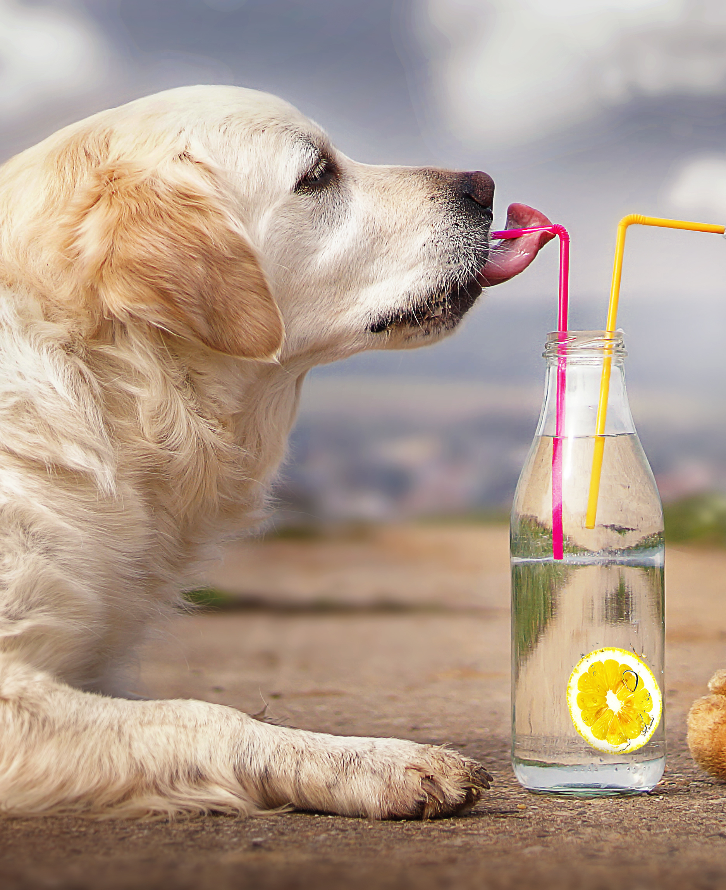
Hydration
HOMEWORK: Figure out… How can I keep my K9(s) fully hydrated when I check /15min?
Hydration
Quantity
Transportation
Drinking Containers
Palatability
Clean
Cold (if possible)
Consider (safe) FLAVORING!!
Notes:
Committing to keeping them well hydrated ALL the time all day every day!
Remember?
importance of panting from before
how to monitor hydration from assessments
Hydration enables effective panting and thus cooling
Containers:
Storage and Transportation (water bottles, jugs, 5Gal for car etc
For drinking (bowls, cups, camelbacks for trails etc)
Compare to chronic human dehydration

Slide 34
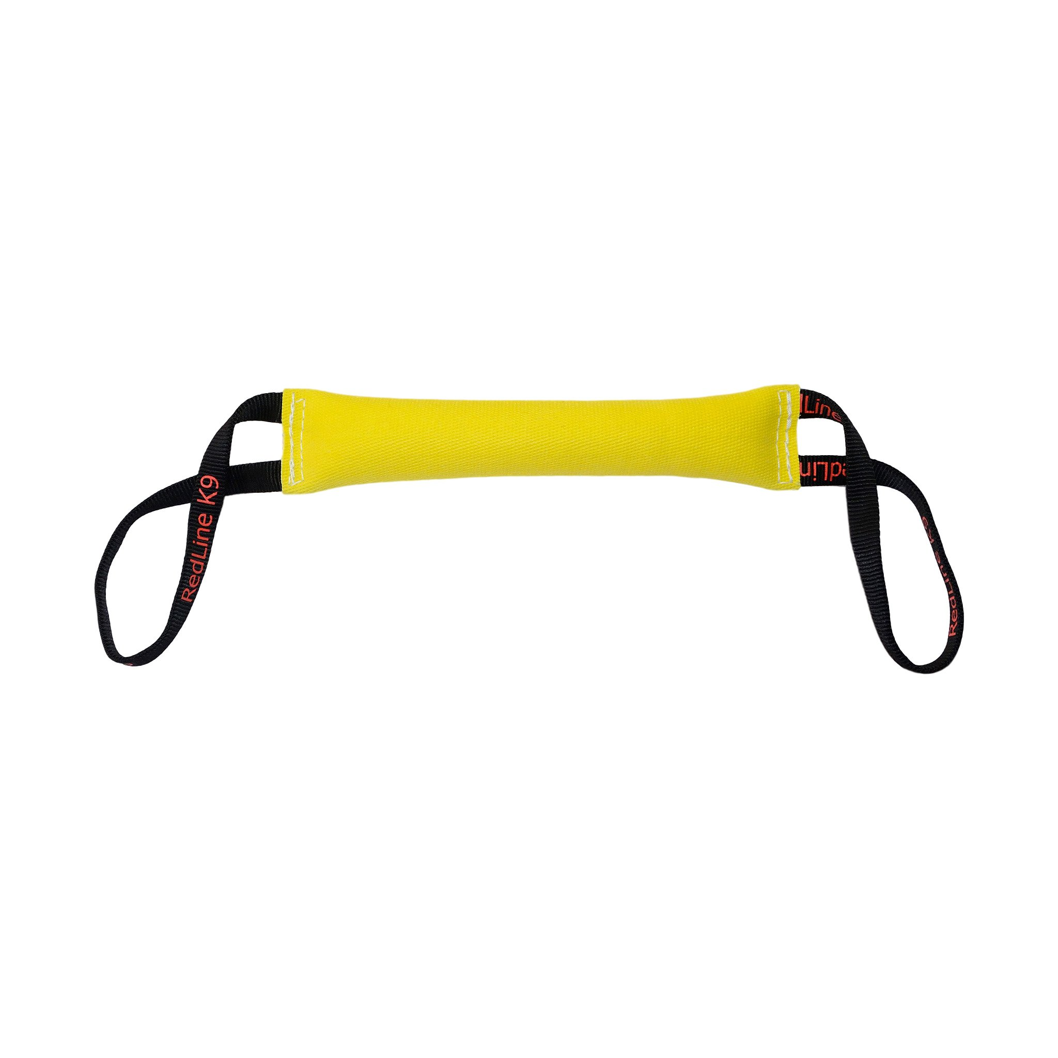
💡Break Tip!
Don’t restrict panting ! Ex. “Possession” of the toy
impairs panting!
Notes:
SO, when I was swiping [dog name’s] mouther earlier, I wasn’t just asking Hey are you Thirsty
I was actually asking [dog’s name] are you physiologically capable of cooling yourself!!!
BECAUSE, if swipe his cheek and it’s dry or tacky,
Do I have Wet + Wind = Cooling?? NO
I have Dry + Wind = Sucks to Be Me
I have Dry + wind that is not physiologically capable of cooling herself.
So, I know I need to know how to hydrate my dog which we cover during the Effective Breaks section. But first.. Let’s talk about how we can support our dogs not just during their work cycle, but how every day choices can build up a more heat resistant dog overall.

Slide 35
When is the break complete?

Slide 36
🎯Key goals for breaks?
Assess exertion curve
Reduce temperature momentum
Provide cooling support
?
Notes:
This slide automatically morphs into the next slide after one second

Slide 37
🎯Key goals for breaks?
Assessed exertion curve
Reduced temperature momentum
Provided cooling support
✅
Notes:
When time and tactics allow

Slide 38
What Happens When Cooling Fails

Slide 39
MILD/ Stress
Heat Injury Continuum 
MODERATE/ Exhaustion
SEVERE/ Stroke
Increased Panting
Behavior Changes
Less responsive?
Shade/water seeking
Less focus/drive
Posture Changes
UNControlled Panting
Behavior changes
Work avoidance
“Disobedience”
Less responsive
Major Neurologic/CNS
Stupor, stumbling, tremors, pupil changes, seizures, coma
Vomiting and Diarrhea
SIGNS

Slide 40
Case Study – Orlando PD
Two dogs – they both do fine and go home that night
Thank you to Orlando PD for letting cameras roll and sharing
What to watch for:
What factors contributed to the dogs heat injuries
What signs/symptoms of heat injury develop?

Slide 41
Case Study
Notes:
Orlando police K-9 unit video: Notes:
Constantly have to work, jump,
Saw signs getting
Not making eye contact with me,something going on, not acting himself, decided to pull him
Have to watch them, because he would have kept hunting
Reached car, knew we more - Vet, calling him As soon as we got inside is when he started rolling his eyes back

Slide 42
MILD/ Stress
Heat Injury Continuum 
MODERATE/ Exhaustion
SEVERE/ Stroke
Increased Panting
Behavior Changes
Less responsive?
Shade/water seeking
Less focus/drive
Posture Changes
UNControlled Panting
Behavior changes
Work avoidance
“Disobedience”
Less responsive
Major Neurologic/CNS
Stupor, stumbling, tremors, pupil changes, seizures, coma
Vomiting and Diarrhea
SIGNS
Increase Breaks
Supportive Cooling
On-going Monitoring
Stop the Work
Active Cooling
Close Monitoring
Heat “CODE”
Emergency Cooling
Emergency Transport
ACTION

Slide 43
HEAT CODE!
Emergency Response for Heat Injuries

Slide 44
Pop Quiz – Cooling Methods Raise your hands if true
Rubbing alcohol on paws is effective and safe
False
Don’t use ice packs because vasoconstriction prevents cooling
False
Don’t use cold water immersion because shivering prevents cooling
False
It’s dangerous to cool a patient too quickly
False - only cardiac/geriatric patients are generally at risk
Notes:
[[This slide animation builds line by line]]
Rubbing alcohol:
It does evaporate and paws are warm HOWEVER, the evaporative effective is very short lived and we want continuous cooling for maximal results
Also, it can be fatal to use copious amounts of alcohol all over their body (we’ve seen some sad cases of infants deaths using that procedure), so stick to water for evaporation
Ice packs - while there may be some local vasoconstriction, there overwhelming cooling impact is much greater than the offset caused by vasoconstriction. It’s not the MOST effective form of cooling which we will talk about shortly, but it is good for supplemental cooling
Cold water immersion shivering prevents cooling
Anyone ever done a polar bear dip and jumped into very cold water? Did you feel warm?
Similar to ice packs, any warmth created by shivering that does happen doesn’t offset the significant cooling of the ice cold water. This is actually technically the most effective way of cooling, but not always field expedient.
Too Fast?
Only true for cardiac/geriatric patients, to the degree that the dogs wouldn’t be working anymore.
Might apply to retired / ill K9s at home
Single Most important thing to remember about this is…. (pause for dramatic effect)….

Slide 45
Truth
You CAN’T Cool a Dog Too FAST
But…
You CAN Cool a Dog Too FAR
~~~~~~~~~~~~~~~~~~~~~~~~~~ Temp at least every 3-5min And
Stop active cooling at 103°F/40°C
Notes:
You CAN’T cool a dog Too FAST
BUT
You CAN cool a dog to FAR
A dog that becomes hypothermic (too cold) is
Less Likely To Survive.
Remember we discussed that at the very beginning of the heat section.
[This slide might be the most important one in the slide deck. We say this first statement with very strong eye contact across the audience making sure that everyone is connecting to this]
We keep saying that Heat is Your Dog’s Brain on a Frying Pan.
If I had my hand on a hot stove element
I would never remove it slowly, I would move as fast as possible
The same is true for K9s
We want to cool the dog as FAST as Possible.
AND we want to stop cooling at about 103F
Temperature has momentum
Just like when we saw the temperature continue to rise even when put the dog in a break.
When we stop active cooling the body temperature will continue to drop, coasting into normal.
Since it’s so important to Stop Active Cooling at the right time
We need to temp at least every 3-5 min
OK, So we are convinced we need to cool fast. Let’s look at the logistics of this.

Slide 46
Truth
You CAN’T Cool a Dog Too FAST
But…
You CAN Cool a Dog Too FAR
~~~~~~~~~~~~~~~~~~~~~~~~~~ Temp at least every 3-5min And
Stop active cooling at 103°F/40°C
HOMEWORK: Label Thermometers: Stop Cooling @103F / 40C
Notes:
You CAN’T cool a dog Too FAST
BUT
You CAN cool a dog to FAR
A dog that becomes hypothermic (too cold) is
Less Likely To Survive.
Remember we discussed that at the very beginning of the heat section.
[This slide might be the most important one in the slide deck. We say this first statement with very strong eye contact across the audience making sure that everyone is connecting to this]
We keep saying that Heat is Your Dog’s Brain on a Frying Pan.
If I had my hand on a hot stove element
I would never remove it slowly, I would move as fast as possible
The same is true for K9s
We want to cool the dog as FAST as Possible.
AND we want to stop cooling at about 103F
Temperature has momentum
Just like when we saw the temperature continue to rise even when put the dog in a break.
When we stop active cooling the body temperature will continue to drop, coasting into normal.
Since it’s so important to Stop Active Cooling at the right time
We need to temp at least every 3-5 min
OK, So we are convinced we need to cool fast. Let’s look at the logistics of this.

Slide 47
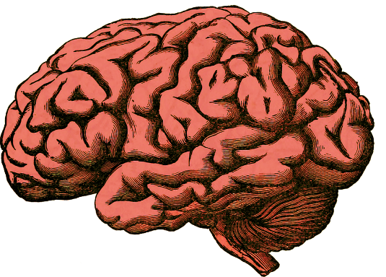
Emergency Cooling - Onsite
Heat stroke is your dog’s brain on a frying pan
Time is brain
Every second counts

Slide 48
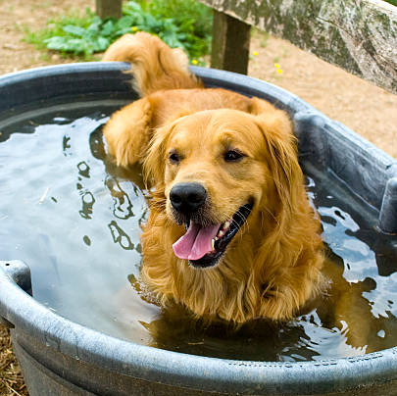
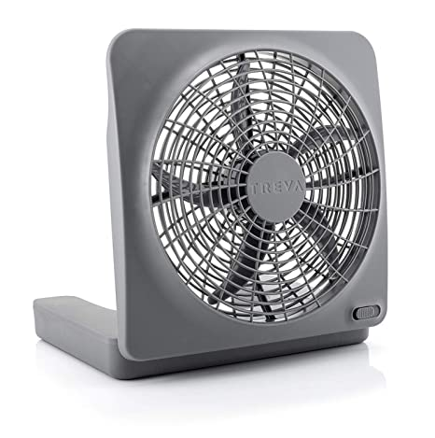
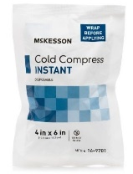
Emergency Cooling - Onsite
Ice/cold water submersion
Best option but not always field friendly
Pool/trough + ice
WET! High-flow/large water sources
River, hoses, pool
Control K9, protect airway, pull fur back
WIND! Optimize wind / airflow
Fans, windows, trample grass
Supplement with ice packs
5 locations incl back of neck
Wet + Wind = Cooling
Notes:
Ice packs are supplemental but the other items above are more effective and should be prioritized

Slide 49
Emergency Cooling - Onsite
Begin temp trending
Start IV if available, time permits
No more than ~5-10 min delay
Have others prep car…
Wet + Wind = Cooling
Notes:
Ice packs are supplemental but the other items above are more effective and should be prioritized

Slide 50
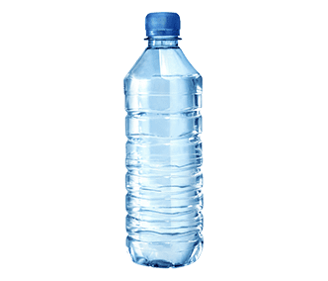
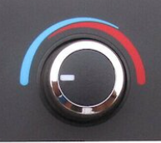
Emergency Cooling - Transit
Ice/cold water
Consider immersion (body bag)
Constantly soaking fur down to skin
Swap towels from water-filled cooler
Optimize wind / airflow
AC + Fans ON, Windows down
Supplement with ice packs
5 locations incl back of neck
Wet + Wind = Cooling
Notes:
Fur was designed to repel water and it works
Explain pulling fur back to get down to the skin

Slide 51
Emergency Cooling - Transit
IV Fluids and O2 if possible
Continue temp trending
Communicate with hospital
Use resources to control traffic
Wet + Wind = Cooling
Notes:
Fur was designed to repel water and it works
Explain pulling fur back to get down to the skin

Slide 52
CALLBACK: Emergency Cooling
Besides cold-water immersion, which is actually the fastest cooling method, the best cooling strategy in the field is….
Wet + Wind = Cooling
.
Notes:
Fur was designed to repel water and it works
Explain pulling fur back to get down to the skin

Slide 53
CALLBACK: Emergency Cooling
Besides cold-water immersion, which is actually the fastest cooling method, the best cooling strategy in the field is….
Wet + Wind = Cooling
Wet + Wind = Cooling
Notes:
#noprint

Slide 54
Emergency Cooling - Transit
IV Fluids and O2 if possible
Continue temp trending
Communicate with hospital
Use resources to control traffic
Wet + Wind = Cooling
Notes:
Fur was designed to repel water and it works
Explain pulling fur back to get down to the skin

Slide 55
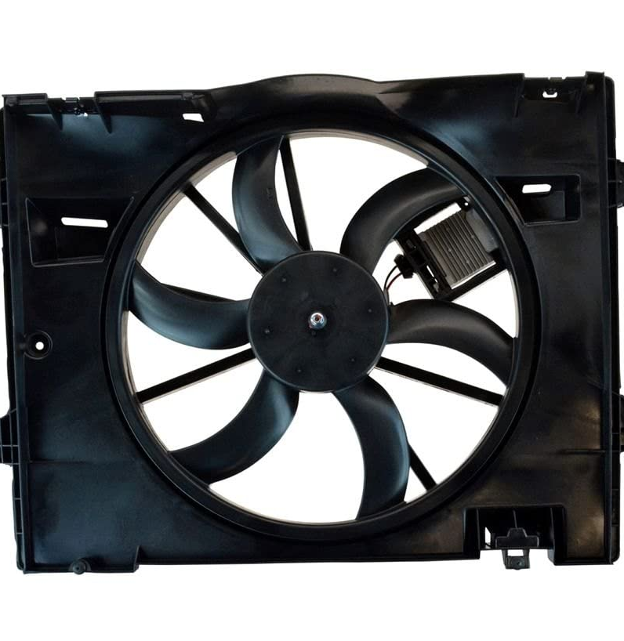
Emergency Cooling - Transit
Wet + Wind = Cooling
HOMEWORK: Identify location in vehicle
that optimizes…
Wet + Wind = Cooling
and SPACE for K9 + Responder + copious water/ice supply
+ towels staged high
Notes:
Fur was designed to repel water and it works
Explain pulling fur back to get down to the skin

Slide 56
When cooled to 103F/40F
Dry Fur
With pre-staged dry towel
Reduce wind / airflow
AC + Fans to NORMAL, Windows Up
Remove ice packs
Reverse all active cooling measure Maintain “room” temp
Notes:
Dry towel is prestaged out the way to keep it dry and out of the way

Slide 57
When cooled to 103F/40F
Continue IV Fluids and O2
Continue monitoring
Briefly actively warm if temp < 100F
Reverse all active cooling measure Maintain “room” temp
Notes:
Fur was designed to repel water and it works
Explain pulling fur back to get down to the skin

Slide 58
Summary: Beat the Heat
Leading Cause Of Preventable Death
Heat Safety ABCs
Assessments (Know Your Dog)
Body Conditioning (exercise in target environments)
Climate Control (optimize acclimatization temps)
Cool as FAST and aggressively as possible
Wet + Wind = Cooling
STOP Cooling at 103F/40C

Slide 59
Heat Stroke Treatment
Cool until temp < 105° F
Use a combination of cooling methods!
The rate of cooling should be as rapidly as possible until the body temperature is 105° F.
Wet plus Wind = Cooling!
Cool to the skin, add fans/AC, etc
<105°, the rate of cooling can be reduced to avoid rebound hypothermia
Once the MWD’s body temperature is <103°
Cease all cooling efforts, monitor temperature continuously,
Provide supportive warming to maintain normal temp,
be prepared to actively warm the patient
Evacuate on an URGENT basis if feasible

Slide 60
Heat Stroke Treatment
Triage with emphasis on mentation, airway and breathing, circulation, and body temperature
Intubate if needed
Protect airway while cooling with water, to reduce chances of aspiration of running water
Supplemental oxygen until normoxemia
Use “blow by” technique -- oxygen masks can increase humidity and prevent maximal heat dissipation
IV Fluids
Essential! Reduces core body temperature, improves circulation and volume

Slide 61
Additional Problems
Initial Patient Response
Moves blood to the surface vessels to maximize conductive cooling
Renal and splanchnic vasoconstriction, peripheral vasodilatation, and increased cardiac output
Over time, if temp remains high
Splanchnic and renal vasoconstriction fail
Venous pooling and hypovolemia or distributive shock
Monitor
Continuous ECG, blood pressure, mucus membrane color, and capillary refill time

Slide 62
Additional Problems
Shock
Manage shock
Monitor blood pressure, lactate clearance, perfusion, and volume status
Glucose, acid-base, and electrolyte abnormalities
If able, monitor blood glucose and venous blood gas analyses every 6-12 hours.
If concurrent pulmonary abnormalities are present, monitor arterial blood gas analysis (or surrogates such as pulse oximetry and capnography).
Supplement maintenance IV fluids with dextrose to 5%, KCl at 20 mEq/L

Slide 63
Additional Problems
Cardiac arrhythmias
Ventricular arrhythmias, common, but rarely require intervention
If hemodynamic compromise, use lidocaine (2 mg/kg IV bolus, then 50-75 mcg/kg/min CRI)
Vomiting and diarrhea
Start famotidine therapy (1 mg/kg IV, IM, or PO q12h
Nausea: ondansetron (1 mg/kg, IV or PO, q12-24h).
If hemorrhagic
Antibiotic therapy
Sucralfate (1 gram PO q8h)
Allow food and water once vomiting has resolved.
Hygiene is critical: change bedding, shave long tail hair and wrap tails to minimize soiling

Slide 64
Additional Problems
DIC
Ideal tools (but may be unavailable):
FFP or canine serum albumin
Coagulation testing
CBCs
Other Assessments
Clotting abnormalities
(e.g., hematoma formation, intracavitary bleeding, epistaxis, hematuria)
This patient needs advanced veterinary care
URGENT evacuation!

