Slide 1
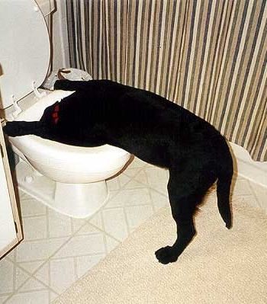
Poisons
More about puke than you ever cared to know

Slide 2
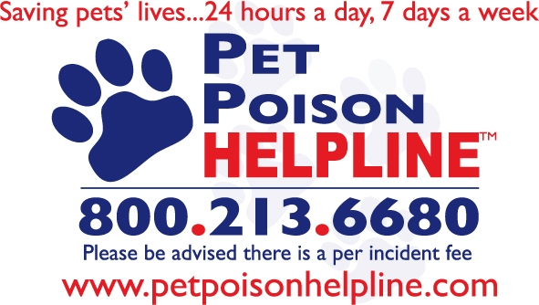
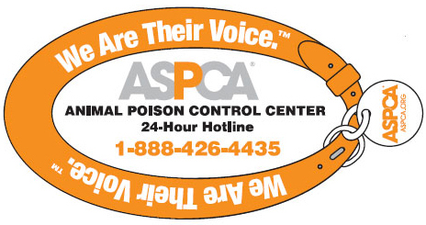
POISONS: Rule #1 If in Doubt, Check it Out
Notes:
About the APCC - How do I get in touch with ASPCA animal poison control experts?
The APCC experts are on call 24 hours a day, 365 days a year. If you think that your pet may have ingested a potentially poisonous substance, make the call that can make all the difference: (888) 426-4435. The call is toll-free. A $65 consultation fee may be applied to your credit card.
24/7 Animal Poison Control Center - Pet Poison Helpline
Pet Poison Helpline is a 24-hour animal poison control service available throughout the U.S., Canada, and the Caribbean for pet owners and veterinary professionals who require assistance with treating a potentially poisoned pet. We have the ability to help every poisoned pet, with all types of poisonings, 24 hours a day. Our knowledge and expertise of pet poisons will put your mind at ease when dealing with a potential emergency.
In order to provide this critical service, please be advised that there is a $35 per incident fee, payable by credit card. This fee covers the initial consultation as well as all follow-up calls associated with the management of the case.
24/7 access to experts in pet poisonings.
Experience. We have managed over 750,000 cases involving pet poisonings.
Veterinary specialists. We're the only poison control with board-certified veterinary internal medicine (DACVIM), emergency critical care (DACVECC) specialists, and veterinary toxicologists (DABVT, DABT) - which is imperative if your pet is critically ill from a potential poisoning!
Why we charge. We're the most cost-effective pet poison control center out there, which is helpful in this current economy. Unfortunately, because there is no public funding to help run animal poison control centers, there is a small per-incident fee of $35. Our sole purpose is to ensure that pets stay healthy. Our single goal is to prevent their injury or illness from potential poisonings. To accomplish this, we operate a 24-hour pet poison control center which requires considerable effort, resources, and expense. Unlike public poison control centers in the human sector, veterinary poison control is allotted no tax dollars to support their existence. Pet Poison Helpline does not receive any state, federal, or other public funding. If we did not charge, we could not exist.
Follow up consultations. Our animal poison control staff will follow up with veterinarians or pet owners to ensure appropriate recommendations can be made throughout the treatment of the pet.
Treatment advice for all varieties of pets. Not only do we manage cat poisonings and dog poisonings, we also assist in the treatment of avian, small mammals, large animal and exotic species (on a per incident fee basis).
Frequently Asked Questions
If you're calling from Puerto Rico or the US Virgin Islands, you can reach Pet Poison Helpline toll-free at 877-416-7319. Other Caribbean islands can reach us at 011-1-952-853-1716.

Slide 3
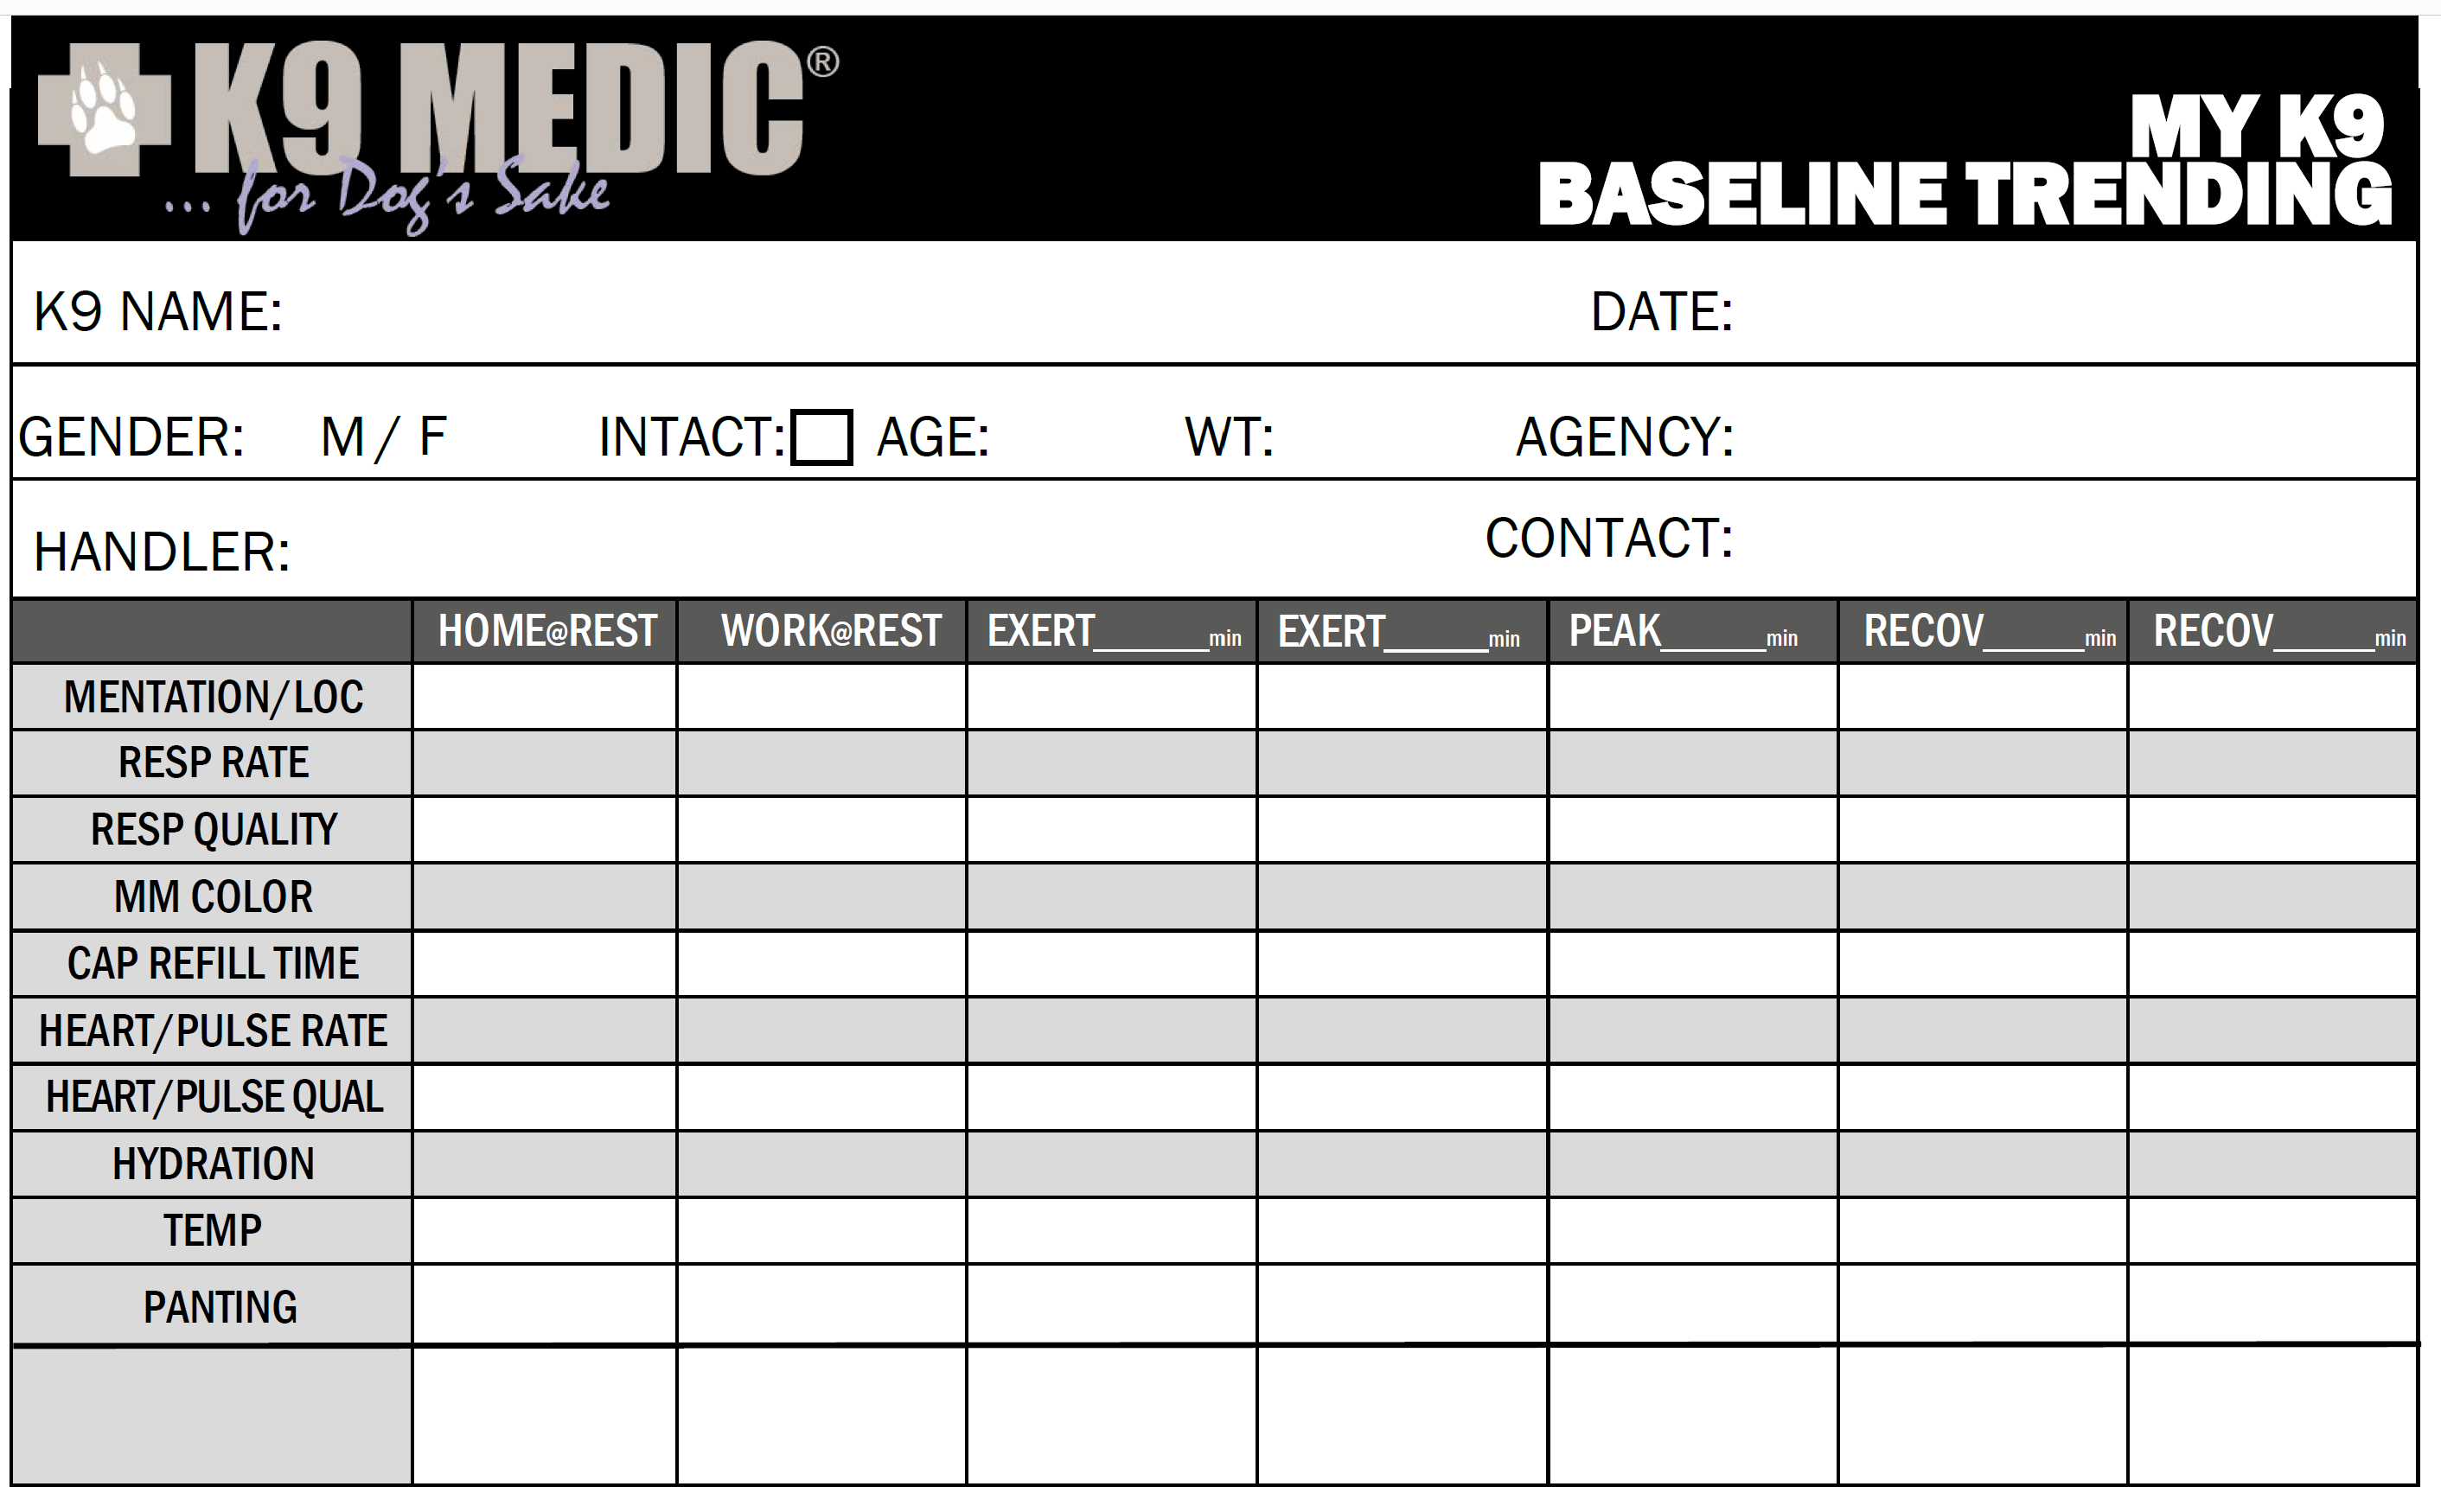
POISONS Rule #2 Know Thy Dog!

Slide 4
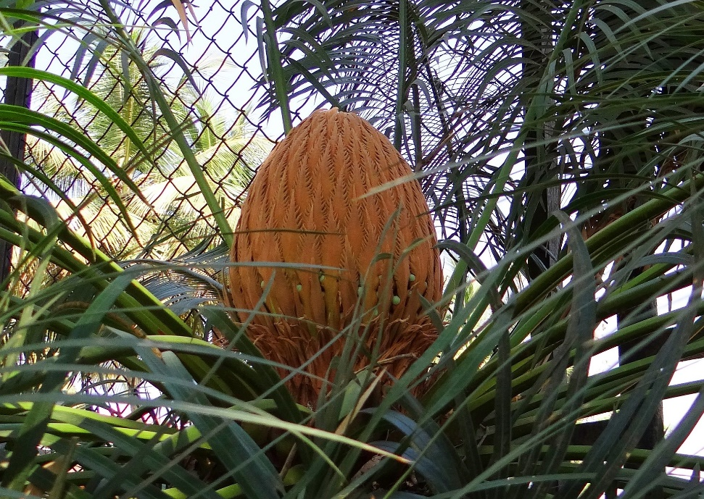
Poisons - Sago Palm
Leading toxic plant for dogs
Any part of the plant
Water run off
Clinical Signs
Gastrointestinal (initial)
Drooling, vomiting, diarrhea
Neurologic
weakness, wobbly gait, tremors, seizures
Liver Failure (2-3) days

Slide 5
Poisons – Other Plants
Too Many to Know and Identify them All…
Common Clinical Signs
Vomiting
Depression
Diarrhea
Dehydration
Lack of appetite
Notes:
Example is Sago Palm
Add another sago

Slide 6
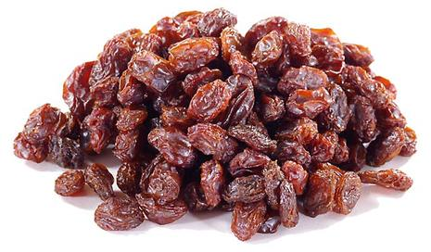
Poisons – Grapes & Raisins & Sultana
Until Recently… a Mystery
Potentially… tartaric acid
Fluctuates widely across crops and even season
Not all pets affected
Sometimes as few as 4-5 grapes
Kidney failure
Signs of Toxicity
Loss of appetite
Vomiting
Dehydration
Notes:
Nephrotoxic → Renal Failure – altering blood supply to the kidnes, not dose dependant, sometimes as few as 4-5 grapes
Aggressive fluid therapy to support kidneys
Unique sensitivity of dogs to tartaric acid and implications for toxicity of grapes” in the April 1, 2021, issue of JAVMA, pages 706–707.
From ASPC Animal Control: (and in the industry considered a "good educated guess")
We propose that tartaric acid and its salt, potassium bitartrate, are the toxic principles in grapes leading to acute renal failure in dogs. Variable concentrations may explain the inconsistency in clinical signs in dogs following grape and raisin ingestion. Furthermore, excess tartrates are removed (detartrated) from commercial wine and juice products to protect flavor and appearance. This removal of potassium bitartrate from processed products could account for the lack of toxicosis following ingestion of products such as juice, jam, and wine.
JAVMA | APR 1, 2021 | VOL 258 | NO. 7 707
https://www.aaha.org/publications/newstat/articles/2021-04/what-causes-grape-toxicity-in-dogs-playdough-might-have-led-to-a-breakthrough/

Slide 7
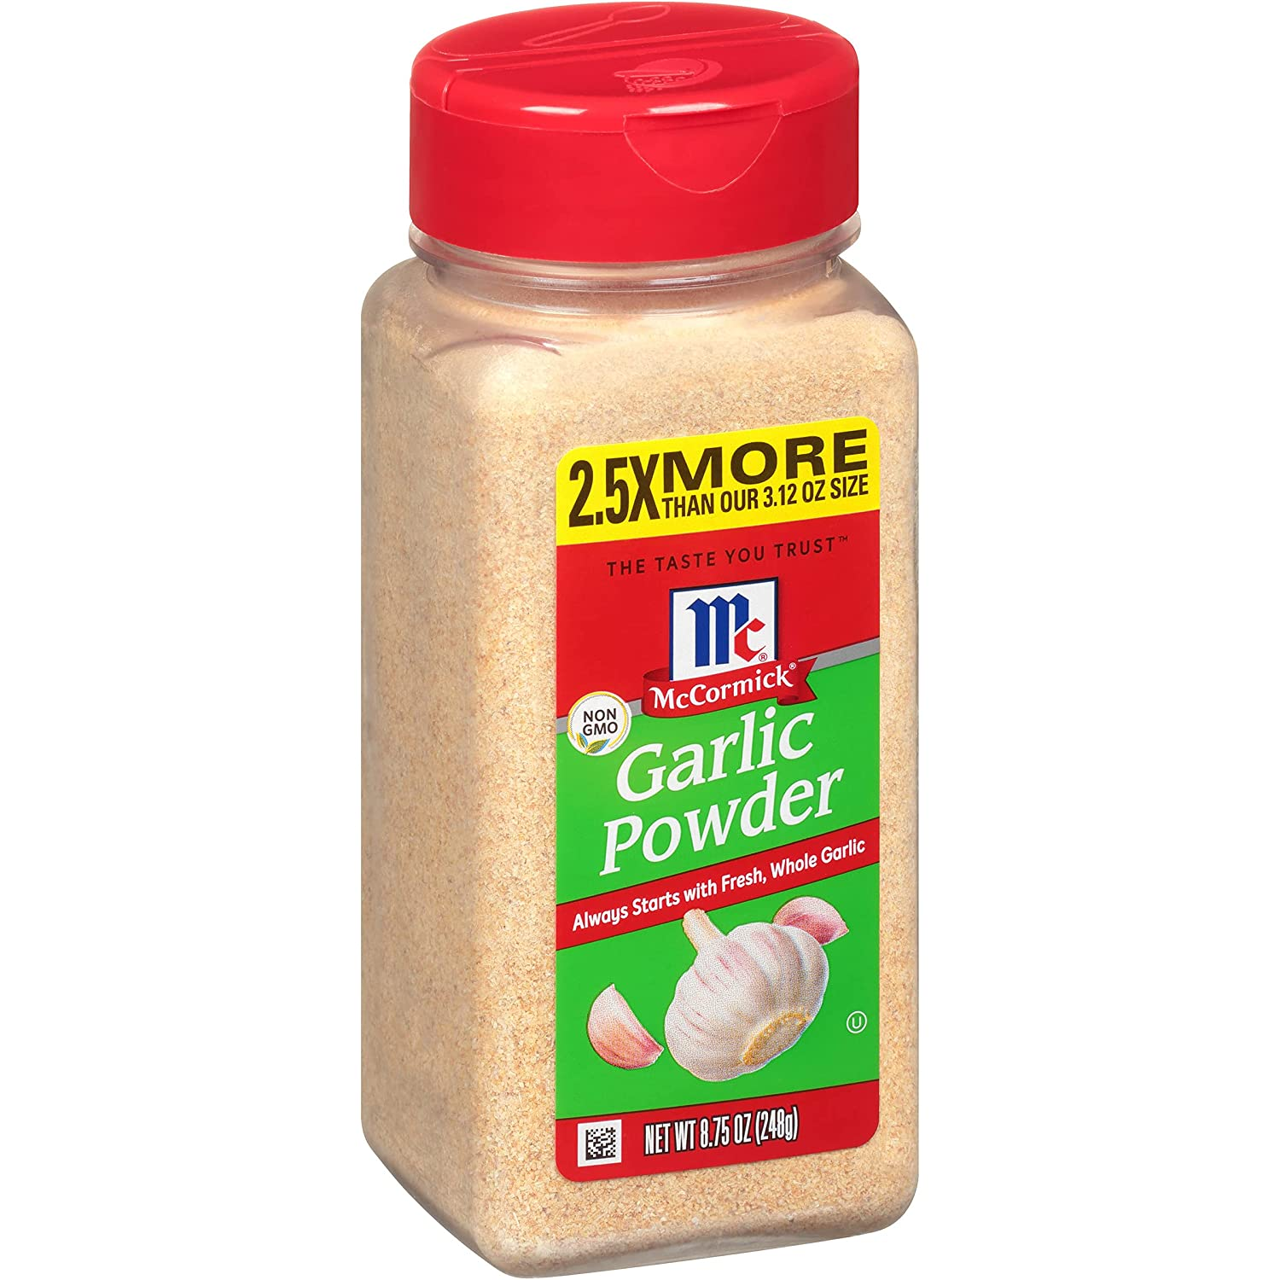
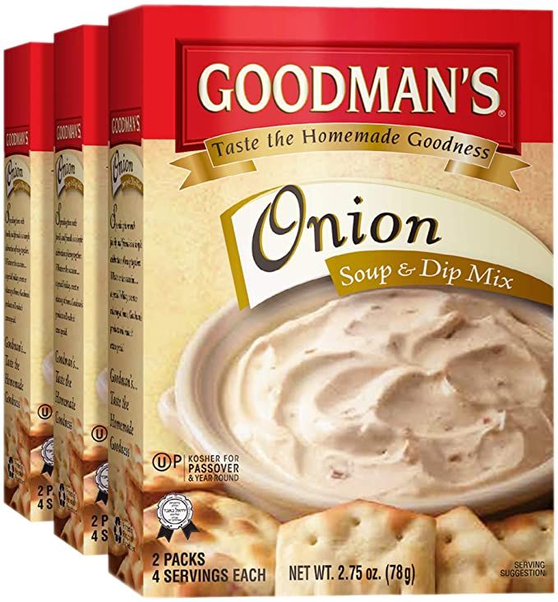
Poisons – Onions and Garlic
Damage Red Blood Cells
Stronger (garlic vs onion)
Concentrated (soup mix, powders)
Signs of Toxicity
Weak
Reluctant to move
Orange to dark red urine
3-5 days later
Notes:
Onions and Garlic
All close members of the onion family (shallots, onions, garlic, scallions, etc.) contain compounds that can damage dogs’ red blood cells if ingested in sufficient quantities. A rule of thumb is “the stronger it is, the more toxic it is.” Garlic tends to be more toxic than onions, on an ounce-for-ounce basis. While it’s uncommon for dogs to eat enough raw onions and garlic to cause serious problems, exposure to concentrated forms of onion or garlic, such as dehydrated onions, onion soup mix or garlic powder, may put dogs at risk of toxicosis. The damage to the red blood cells caused by onions and garlic generally doesn’t become apparent until three to five days after a dog eats these vegetables. Affected dogs may seem weak or reluctant to move, or they may appear to tire easily after mild exercise. Their urine may be orange-tinged to dark red in color. These dogs should be examined by a veterinarian immediately. In severe cases, blood transfusions may be needed.

Slide 8
Pop Quiz!
Poisons - Chocolate

Slide 9
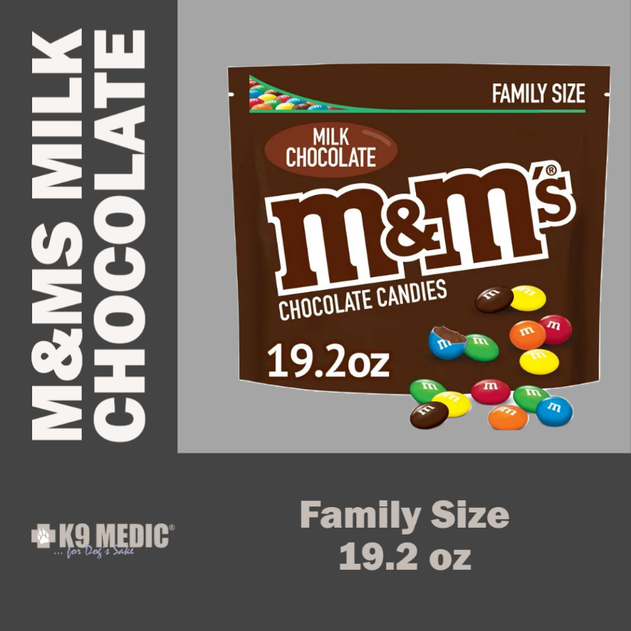
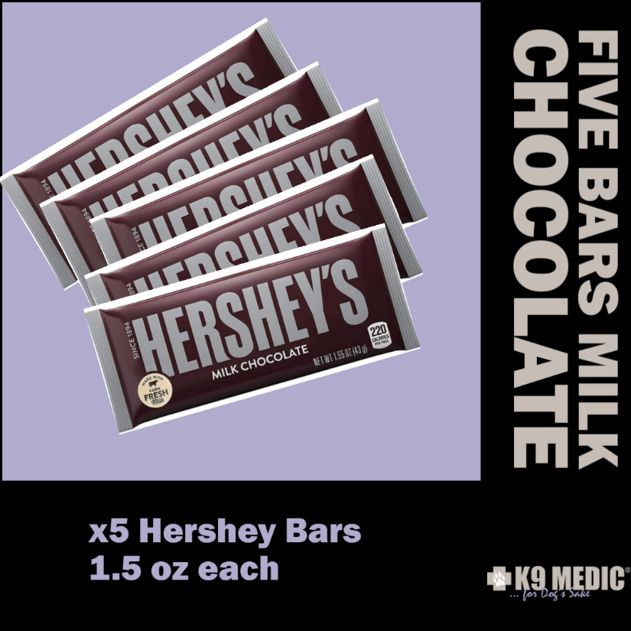
Pop Quiz!
Poisons - Chocolate

Slide 10
Poisons - Chocolate

Slide 11
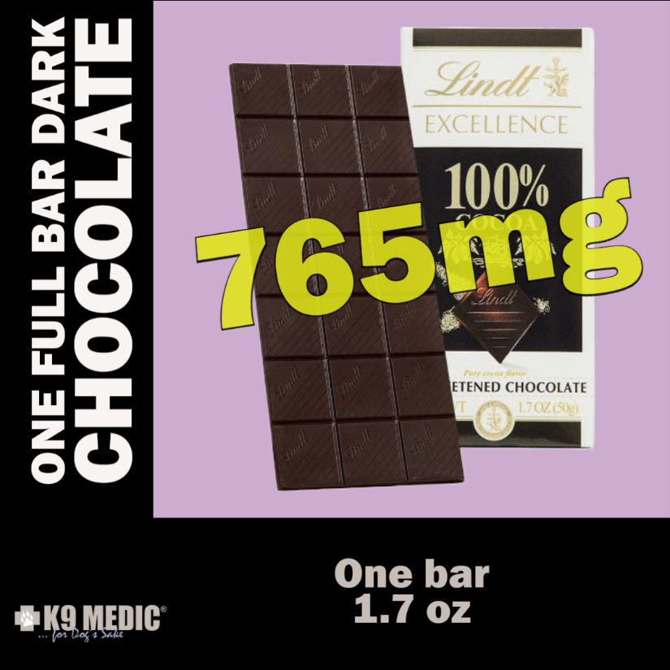
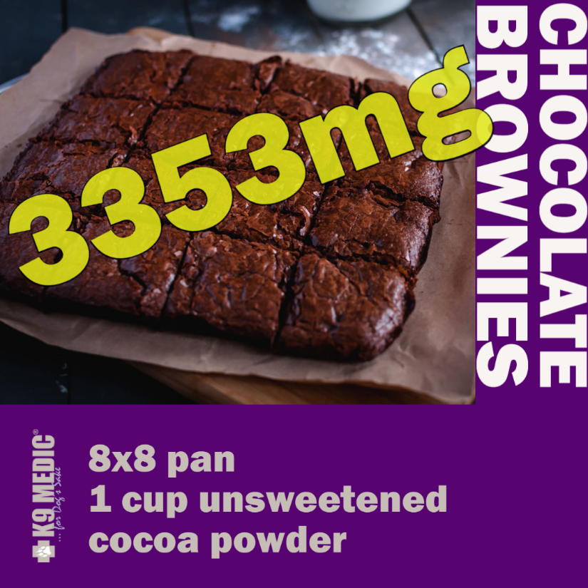
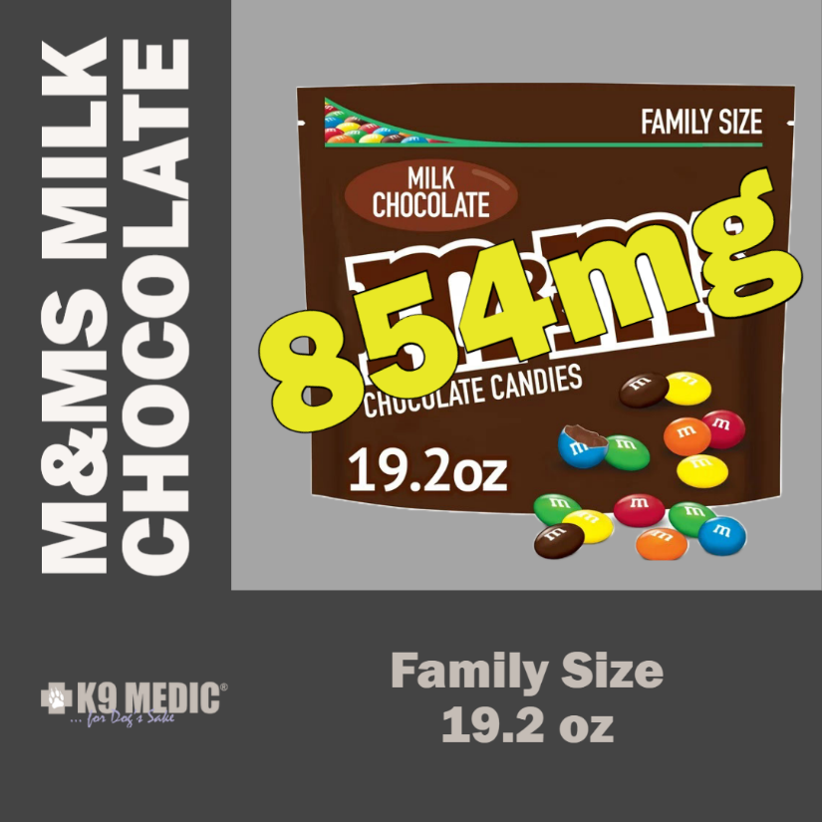
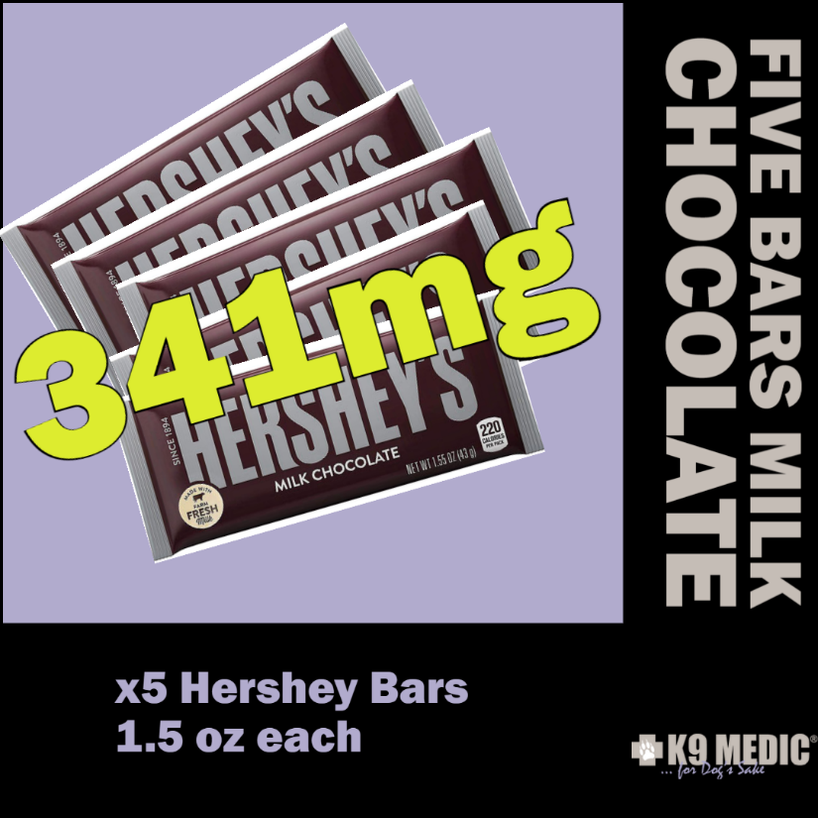
Expect Vomiting and Diarrhea
FATAL If Untreated
Poisons - Chocolate
Expect Vomiting Diarrhea Tachyarythmias
Mild, but
When in
Doubt
Check it
Out

Slide 12
Poisons - Chocolate

Slide 13
Poisons - Chocolate
Signs of toxicity?
Vomiting / diarrhea
Excitement / nervousness / trembling
Excessive thirst / sometimes excessive urination
Muscle spasms
Seizures
Coma (rare)
Death (rare)
likely due to heart rhythm abnormalities
Notes:
(within 12 hrs or less)
Why isn't chocolate toxic to humans? Humans can break down and excrete Theobromine much more efficiently than dogs. The half life of Theobromine in the dog is long; approximately 17.5 hours.

Slide 14
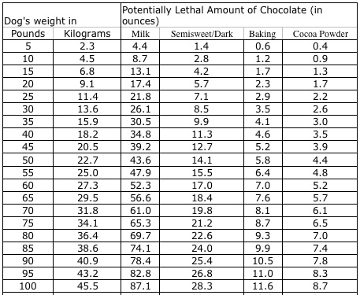
How Much?
60 LB Lab:
Milk: 3lbs
Dark: 1lb
New Specialty less

Slide 15
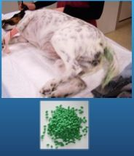
Poisons – Snail Bait – Metaldehyde
Neurologic → Develop within 1 hour post-ingestion
Severe whole body Twitching and Tremors
Weakness and/or uncoordinated movement
Anxiety
Progressing to full seizures
→ raises body temperature → brain damage
Salivation, racing heart rates, vomiting, diarrhea, & rigidity
Secondary liver failure syndrome 2 to 3 days after poisoning,
Less than a teaspoon per 10 lb of body weight
Many products also contain insecticides that make them even more toxic.
Notes:
California, snail bait constitutes the most common poisoning agent in dogs. Malicious poisoning is not the issue; most cases are inadvertent as many gardens have both dogs and snail problems. Snail bait is commonly formulated in pellets, which can resemble dog food, and is flavored with molasses or bran to attract snails, which unfortunately is attractive to dogs as well. Snail baits are also available as liquids and powders that can get onto paws and be licked off in normal grooming. Very little snail bait is required to cause poisoning, less than a teaspoon per 10 lbs of body weight.
Many products also contain insecticides that make them even more toxic.
Metaldehyde is a common component of molluscacides e.g. snail and slug baits. ¹⁻³ Commercial products are formulated in granular or liquid form and are applied around walkways and in garden areas. Some products may also contain a carbamate too. ³ Dogs are exposed to metaldehyde-containing snail bait either by ingestion of bait that is scattered for snail control or by direct ingestion of bait from an inappropriately stored container. ¹ Ingestion of 2 ounces of a 3 % bait (1800 mg metaldehyde) by a 10 kg dog will induce clinical signs within an hour. ³ The exact pathogenesis of metaldehyde toxicity is unknown. Gamma-aminobutyric acid and 5-hydroxytryptamine levels are decreased and monoamine oxidase levels are increased in the brain.
Clinical signs occur rapidly (sometimes within an hour) post-ingestion and include vomiting (due to stomach irritation), ataxia or stiffness, hypersalivation, tremors, hyperthermia, tachycardia, hyperesthesia, and tachypnea. Nystagmus can occur, especially in cats.³ Opisthotonos, recumbency, and continuous tonic convulsions, not elicited by light and noise, may occur progressing to loss of consciousness. Decreased respiratory effort results in cyanosis and death due to respiratory failure. Severe metabolic acidosis may occur due to acetaldehyde oxidation. Delayed hepatic failure and transient blindness have also been reported

Slide 16
Poisons - Rodenticides - Anticoagulants
Clinical Signs
Spontaneous Bleeding 3- 5 days post ingestion
Internal or External
Weakness and/or uncoordinated movement
Depression and anorexia even before bleeding occurs
Some forms persist in system for 4-6 weeks
Warfarin and similar drugs
Notes:
Anticoagulant (Warfarin and Congeners):

Slide 17
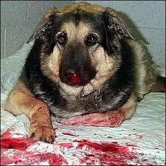
Poisons - Rodenticides - Anticoagulants
Notes:
Anticoagulant (Warfarin and Congeners):
This section to be updated

Slide 18
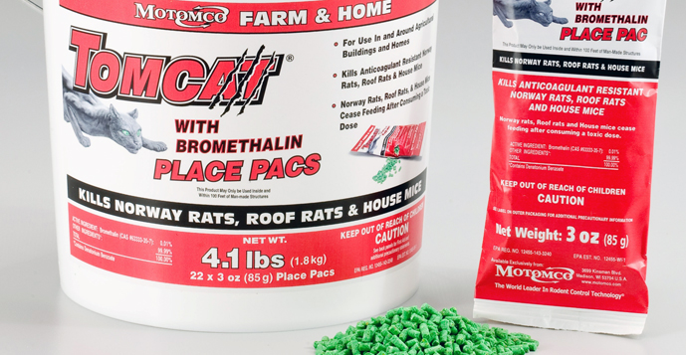
Poisons - Rodenticides - BROMETHALIN
Clinical Signs
CNS dysfunction
Onset 4 hours to 7 days after ingestion
Dose Dependent Toxicity
No Antidote !!!!
Notes:
Anticoagulant (Warfarin and Congeners):

Slide 19
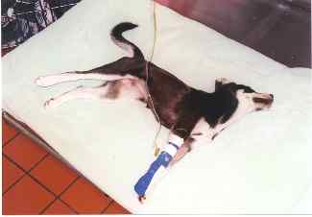
Poisons - Rodenticides - BROMETHALIN
Hyperstimulation-like (convulsant syndrome)
Tremors,
Hyperaesthesia,
Purposeless circling,
Unprovoked vocalization,
Hyperthermia,
Seizures
Opisthotonus progressing to depression and death

Slide 20
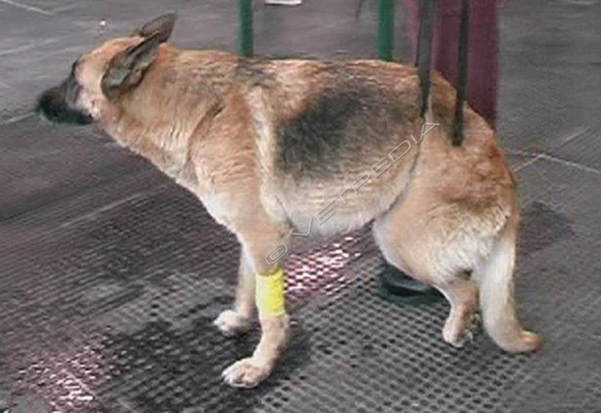
Poisons - Rodenticides - BROMETHALIN
Depressive — paralytic form
Signs in 1 to 7 d increase over 1 to 2 wks
Depression
Disorientation
Ataxia and rear limb weakness
Partial paresis → generalized paralyses
Decreased pain response
Altered bladder tone

Slide 21
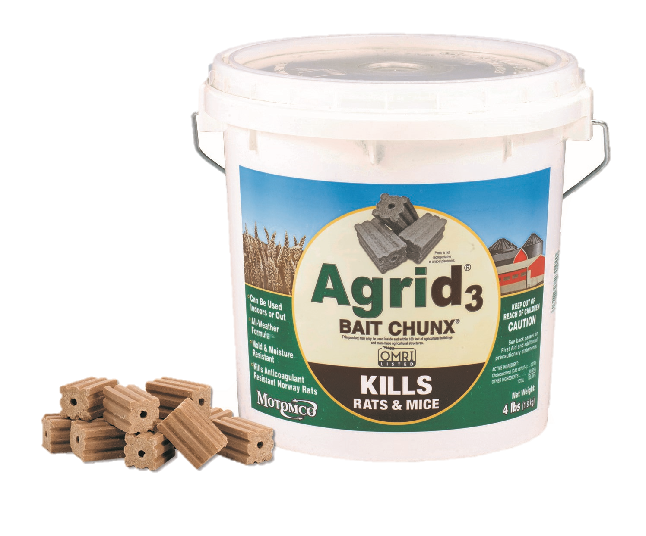
Poisons – Rodenticides – Cholecalciferol
Vitamin D
Clinical signs generally develop within 18–36 hr of ingestion;
depression, anorexia, polyuria, and polydipsia.
nausea, vomiting, hematemesis common as clinical signs progress.
Decontamination
emesis and activated charcoal)

Slide 22
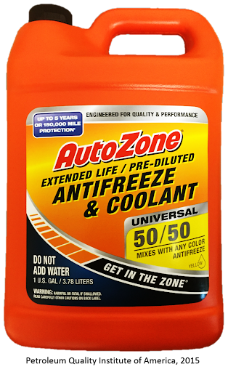
Poisons – Ethylene Glycol
Found in antifreeze, rust removers, etc.
Tastes Great!
Small amounts can be lethal
Less than ¾ cup for 60 lb (27.3 kg) K9
Clinical Signs
Vomiting, depression, excessive urination
Lack of coordination, acts “drunk”
Large dose → Seizures and Coma within hours
Notes:
Min lethal dose is 1.4 mL / kg for the cat and 5.0ml/kg for a dog
Test kits good for first 24hrs
2nd phase 24-72 hrs associate with renal failure
3hrs post ingestion 90% of antifreeze can be extreted unmetabolized

Slide 23
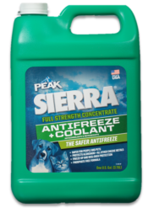
Dog Safer Antifreeze
Propylene glycol (PG) antifreeze
Less toxic anti-freeze option
Also tastes sweet
Still potentially dangerous in larger volumes
Notes:
According to Rob Pratt of Safe Brands, the manufacturer of Sierra, one to two teaspoons of EG antifreeze can cause death in a housecat, whereas the threshold for PG antifreeze is 5 to 10 times that amount. It is important to note that while Sierra is LESS toxic, it is certainly not NON toxic. Both EG and PG taste slightly sweet, like an industrial maple syrup, and under no circumstances should be left where children or pets can be exposed to them.

Slide 24
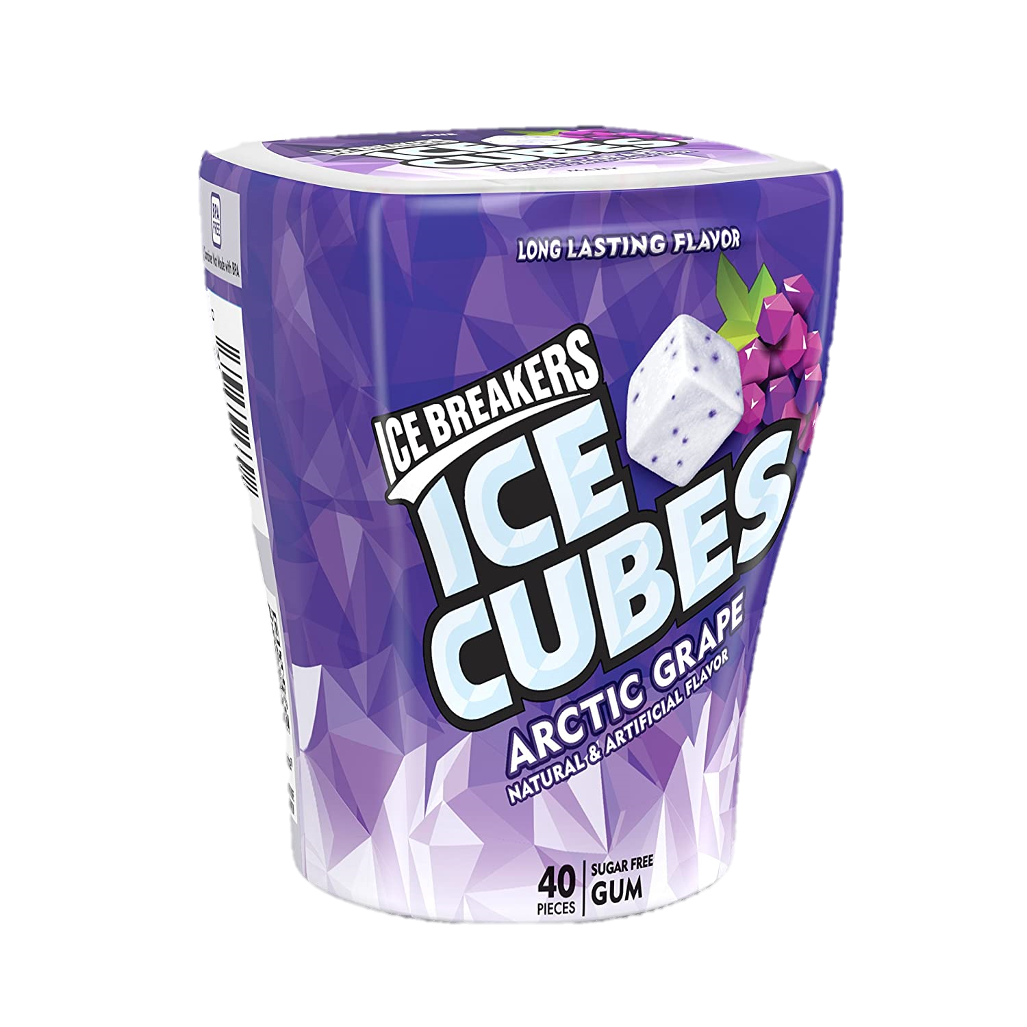
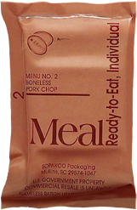
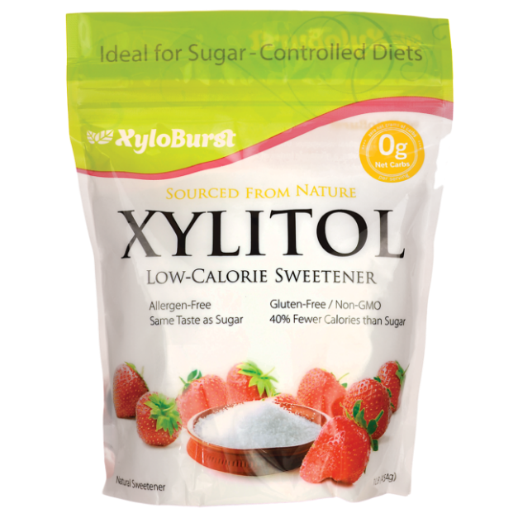
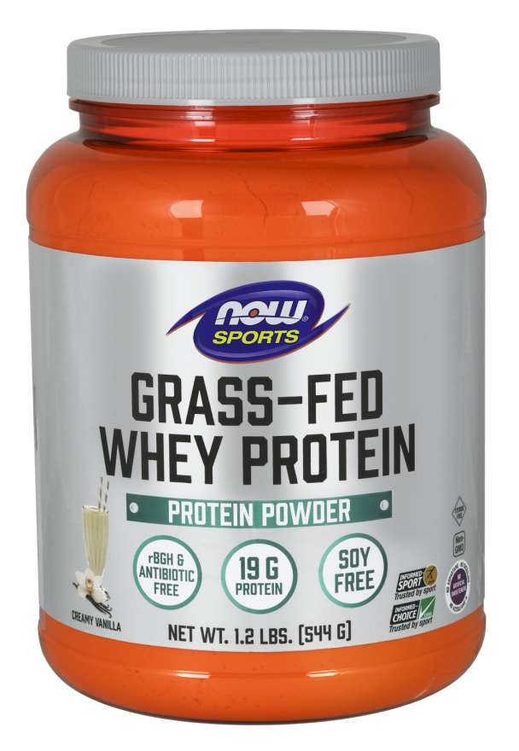
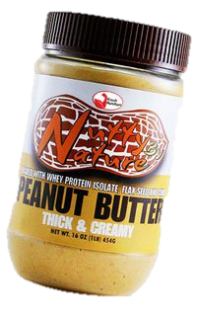
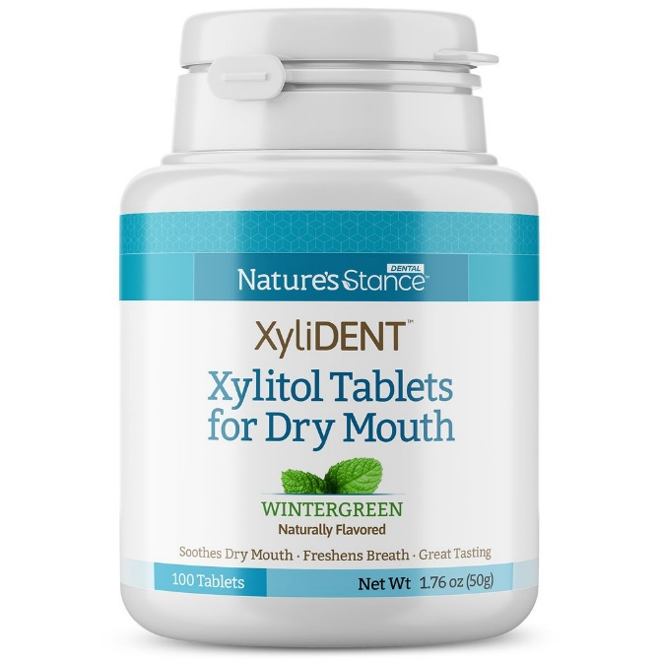
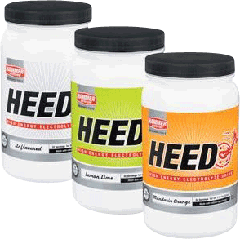
Poisons - Xylitol
https://www.preventivevet.com/xylitol-products-toxic-for-dogs
Notes:
2800 cases pet poison hotline, 2015
Chart prepared by Carlye Rose, D.V.M., Diplomate A.B.V.P.
http://www.armymedicine.army.mil/hc/healthtips/13/200403mre.cfm
Hypoglycemia following canine ingestion of xylitol-containing gum.
Dunayer EK.
ASPCA Animal Poison Control Center, 1717 S Philo Rd, Suite 36, Urbana, IL 61802, USA.
Erratum in:
Vet Hum Toxicol. 2004 Jun;46(3):137.
A 9-mo-old neutered male Labrador Retriever developed severe hypoglycemia, collapse, and seizures after consuming a large quantity of sugar-free gum sweetened with the sugar-alcohol xylitol. The dog was treated with i.v. boluses and continuous infusion of dextrose; its condition improved rapidly, but the dog remained mildly hypoglycemic for 11 hours before recovering fully. In humans, xylitol has little to no effect on plasma insulin or glucose levels, but in dogs xylitol is a strong promoter of insulin release and can cause severe hypoglycemia with ataxia, collapse and seizures. With the increased appearance of xylitol-sweetened products in the US, xylitol toxicosis in dogs may become more common.
PMID: 15080212 [PubMed - indexed for MEDLINE]
Publication Types, MeSH Terms, Substances
Publication Types:
Case Reports
MeSH Terms:
Animals
Diagnosis, Differential
Dog Diseases/chemically induced
Dog Diseases/diagnosis*
Dog Diseases/pathology
Dogs
Gingiva
Hypoglycemia/chemically induced
Hypoglycemia/diagnosis
Hypoglycemia/veterinary*
Male
Sweetening Agents/adverse effects*
Xylitol/adverse effects*
Substances:
Sweetening Agents
Xylitol
LinkOut - more resources
Acute hepatic failure and coagulopathy associated with xylitol ingestion in eight dogs.
Dunayer EK, Gwaltney-Brant SM.
American Society for the Prevention of Cruelty to Animals Animal Poison Control Center, 1717 S Philo Rd, Ste 36, Urbana, IL 61802-6044, USA.
CASE DESCRIPTION: 8 adult dogs were evaluated for treatment of lethargy and vomiting after ingestion of xylitol, a sugar alcohol used as a sweetener in various products. CLINICAL FINDINGS: In addition to vomiting and lethargy, 5 of the dogs had widespread petechial, ecchymotic, or gastrointestinal tract hemorrhages. Common clinicopathologic findings included moderately to severely high serum activities of liver enzymes, hyperbilirubinemia, hypoglycemia, hyperphosphatemia, prolonged clotting times, and thrombocytopenia. Necropsies were performed on 3 dogs and severe hepatic necrosis was found in 2. In the third dog, histologic examination revealed severe hepatocyte loss or atrophy with lobular collapse. TREATMENT AND OUTCOME: Treatments varied among dogs and included IV administration of fluids; plasma transfusions; and, if indicated, administration of dextrose. Three dogs were euthanatized, 2 dogs died, 2 dogs made a complete recovery, and 1 dog was recovering but was lost to follow-up. CLINICAL RELEVANCE: Although xylitol causes hypoglycemia in dogs, hepatic failure after ingestion has not previously been reported. Because an increasing number of consumer products contain xylitol, clinicians should be aware that ingestion of xylitol can have serious, life-threatening effects.

Slide 25
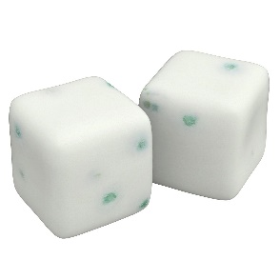
Poisons - Xylitol
Signs
Vomiting is often the first symptom
Signs of hypoglycemia (lethargy, weakness) occur rapidly
Diarrhea, collapse and seizures may be seen
Acute Liver Failure
Without above signs
Develops 2-3 days post exposure
How Much?
2-4 pieces in a 60lb dog can cause hypoglycemia
Notes:
15min to hours for hypo
Can be Days for acute
It takes very little xylitol to cause signs of toxicity in dogs. The ASPCA Animal Poison Control Center (APCC) has reported that dogs ingesting greater than 0.1 g/kg of xylitol should be considered at risk for hypoglycemia. At doses exceeding 0.5 g/kg, there is risk of liver failure and other more serious effects.
It is often difficult to determine exactly how many grams of xylitol were ingested. Although the xylitol content is more commonly listed on food products, this is not the case with many chewing gums. In general, we estimate that one or two pieces of gum could cause hypoglycemia in a 20 lb dog. For granulated (baking) xylitol, one cup weighs about 190 grams. Treating with Dextrose, oral glucose may help

Slide 26
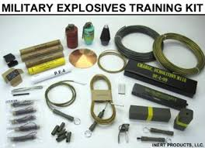
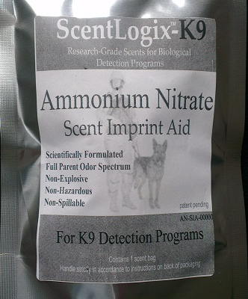
Training Aids
Know what you are training with!
Be prepared
MSDS on HAND
BAM! (Thanks to VTG)
Barf
Activated Charcoal
Move!

Slide 27
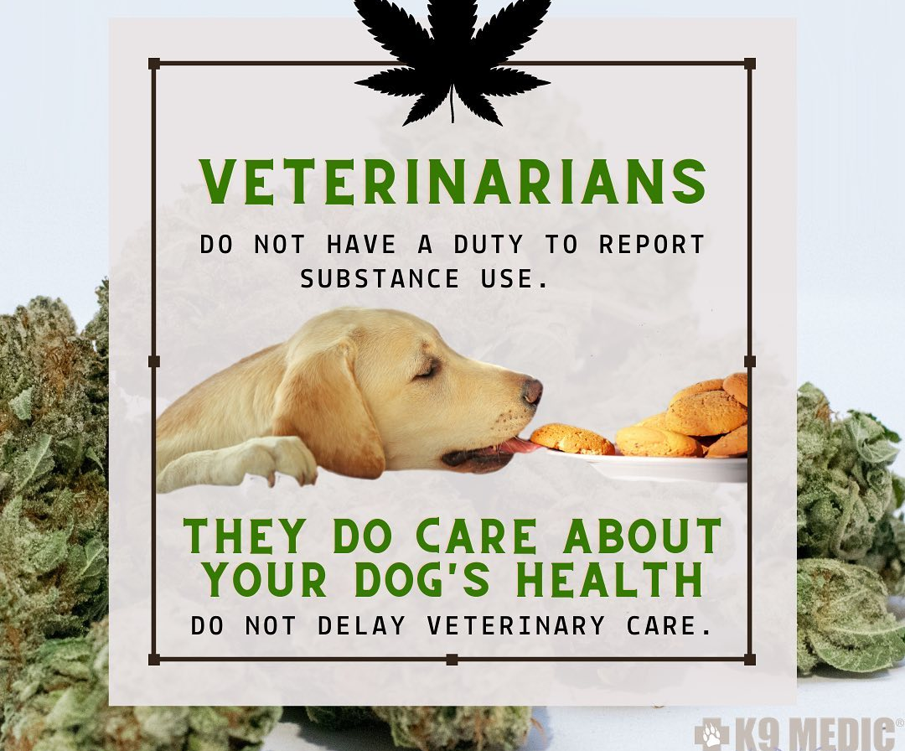
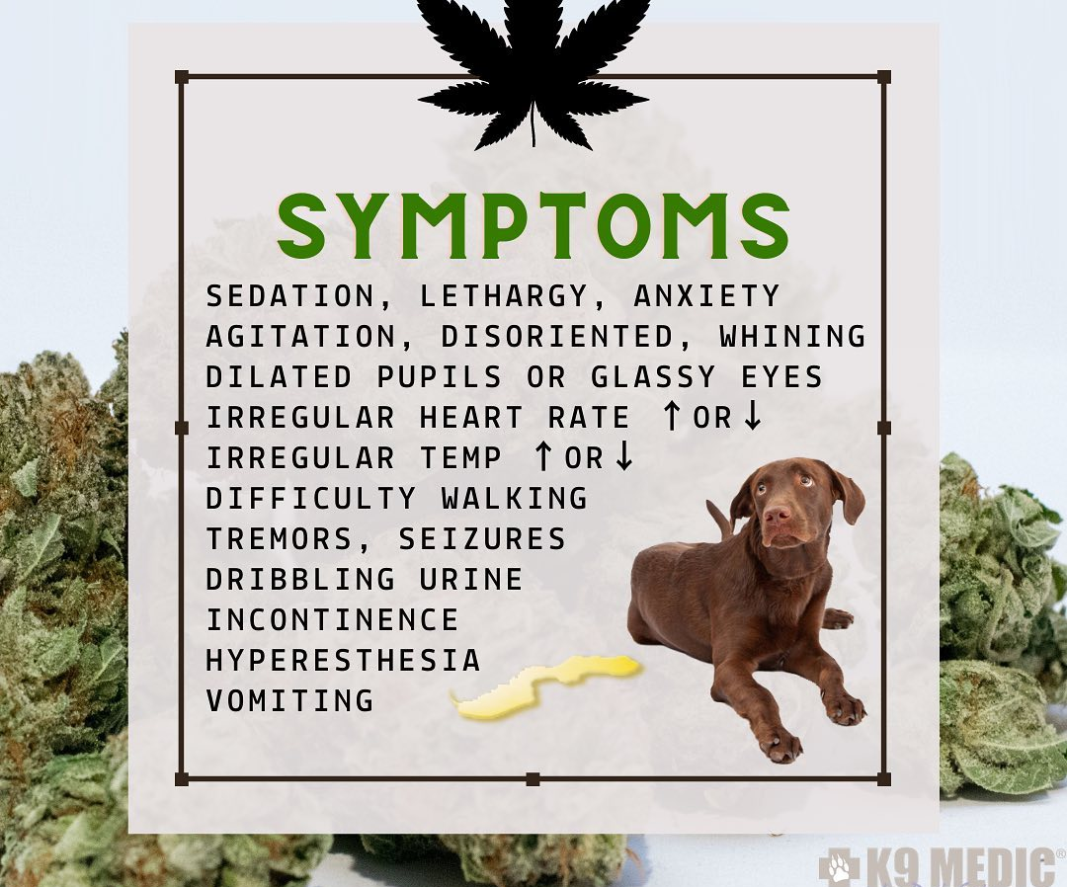
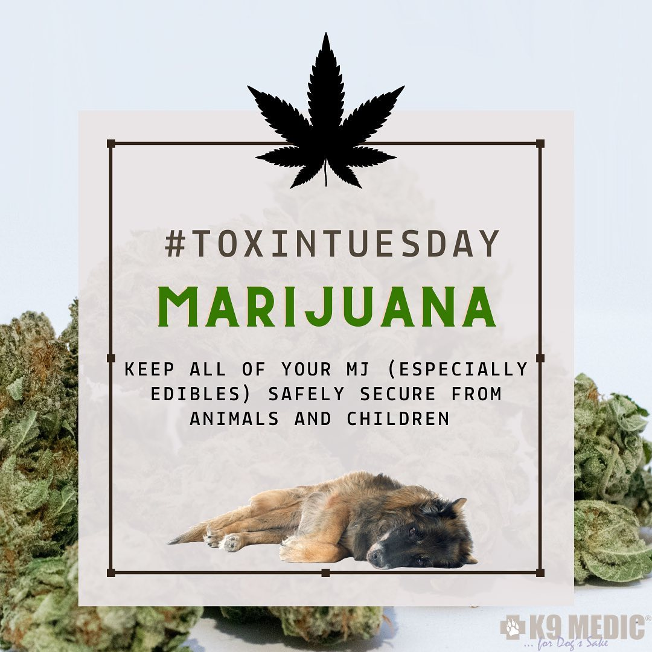
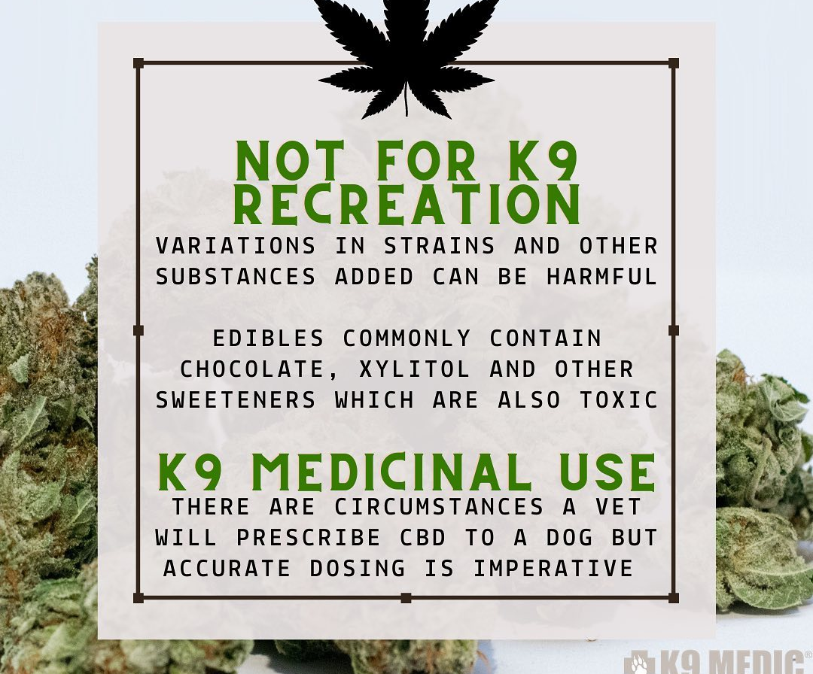
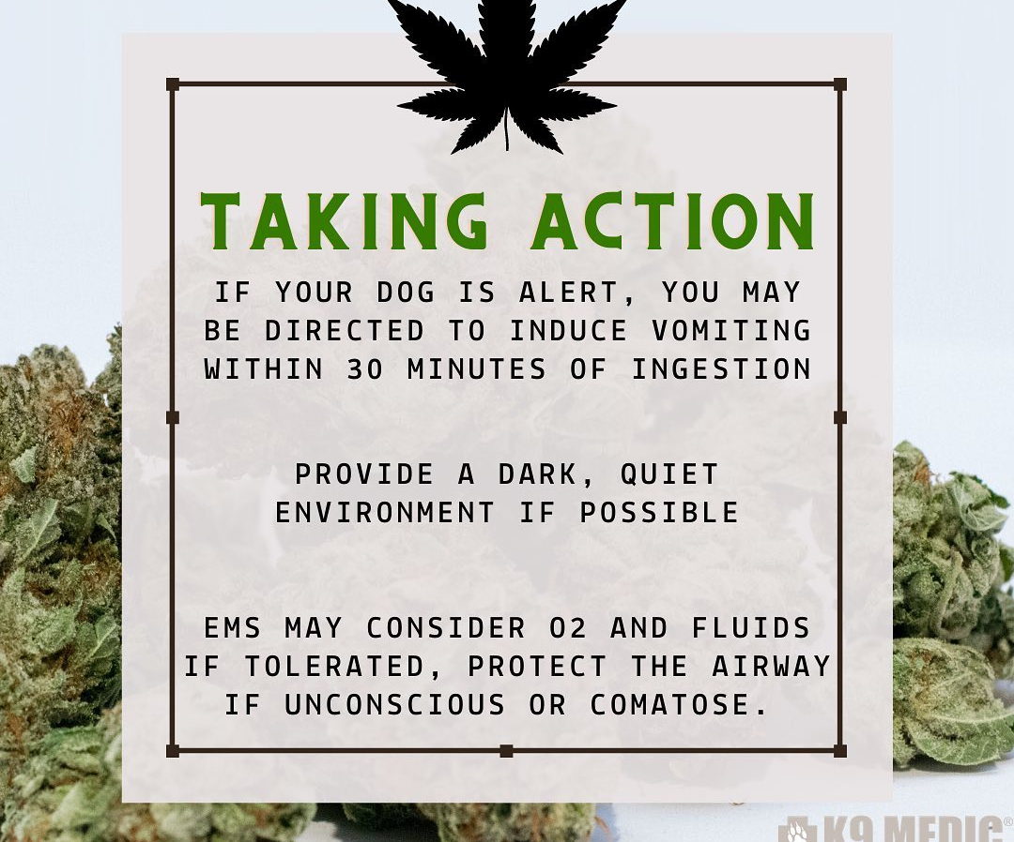

Slide 28
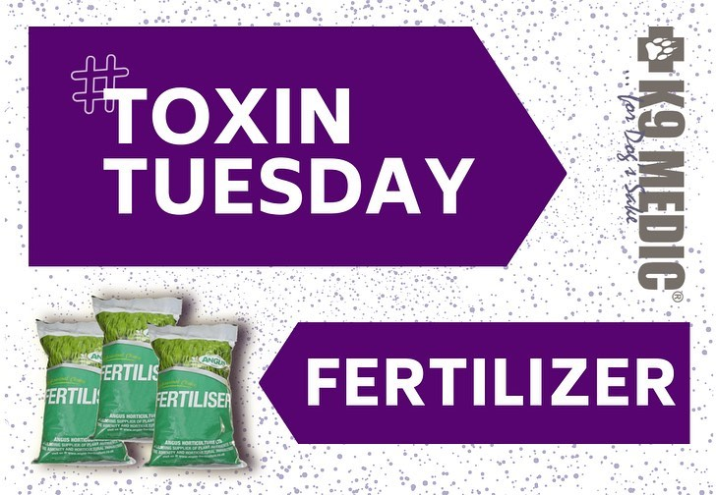
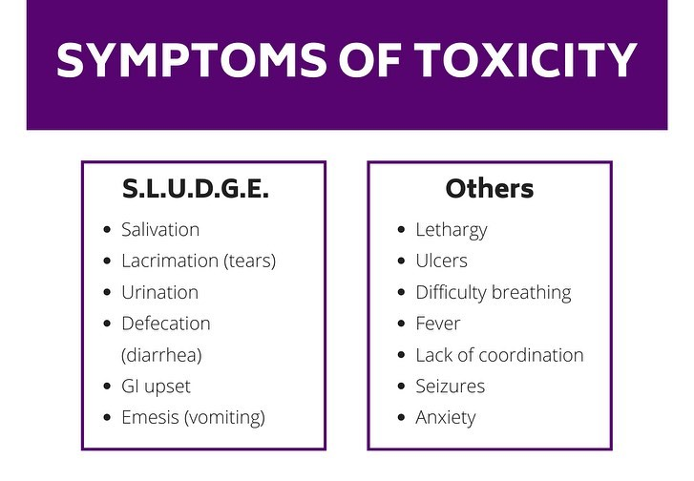
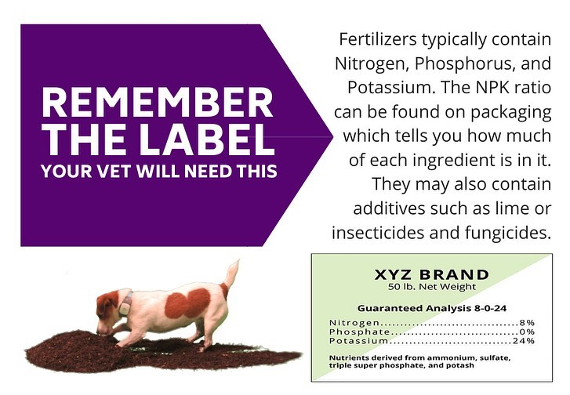

Slide 29
Drug Exposures
Marijuana/hashish.
Ingestion may result in altered mentation (disorientation), hallucinations (in the dog, typically manifested as vocalizing, useless scratching, hyperexcitability), nausea and vomiting, and respiratory distress.
Heroin.
Ingestion may result in bradycardia, respiratory distress, miosis, coma, and sudden death.
Cocaine and amphetamines.
Ingestion may result in restlessness, tachycardia, hyperexcitability, vocalization, excessive or unprovoked aggression, seizures, and mydriasis

Slide 30
Explosive Exposures
Nitrate/nitroglycerin-based explosives.
Ingestion may result in hypersalivation, severe CNS abnormali-ties (ataxia, incoordination, seizures, tremors), gastrointestinal irritation (nausea, vomiting), and methemoglobinemia (cyanosis, weakness, syncope, respiratory distress).
Smokeless powder explosive.
Ingestion may result in hypotension, CNS depression (ataxia, depressed mentation, incoordination), and methemoglobinemia (cyanosis, weakness, syncope, respiratory distress).
Potassium and sodium chlorate explosives.
Ingestion may result in methemoglobinemia (cyanosis, weakness, syncope, and respiratory distress), CNS abnormalities (ataxia, incoordination, and depressed mentation), gastrointestinal irritation (nausea, vomiting, abdominal cramping and pain, hemorrhagic diarrhea with melena or hematochezia), hematuria, hemoglobinuria, and renal and liver failure

Slide 31
Drug Exposures
Marijuana/hashish.
Ingestion may result in altered mentation (disorientation), hallucinations (in the dog, typically manifested as vocalizing, useless scratching, hyperexcitability), nausea and vomiting, and respiratory distress.
Heroin.
Ingestion may result in bradycardia, respiratory distress, miosis, coma, and sudden death.
Cocaine and amphetamines.
Ingestion may result in restlessness, tachycardia, hyperexcitability, vocalization, excessive or unprovoked aggression, seizures, and mydriasis

Slide 32
Inducing Vomiting
As director by Veterinarian or Pet Poison Control
Typically less <4hrs after ingestion
Never induce vomiting for Caustic/acids
Never induce vomiting for Semi/unconscious patient

Slide 33
Clevor®
Notes:
Salt / no salt

Slide 34
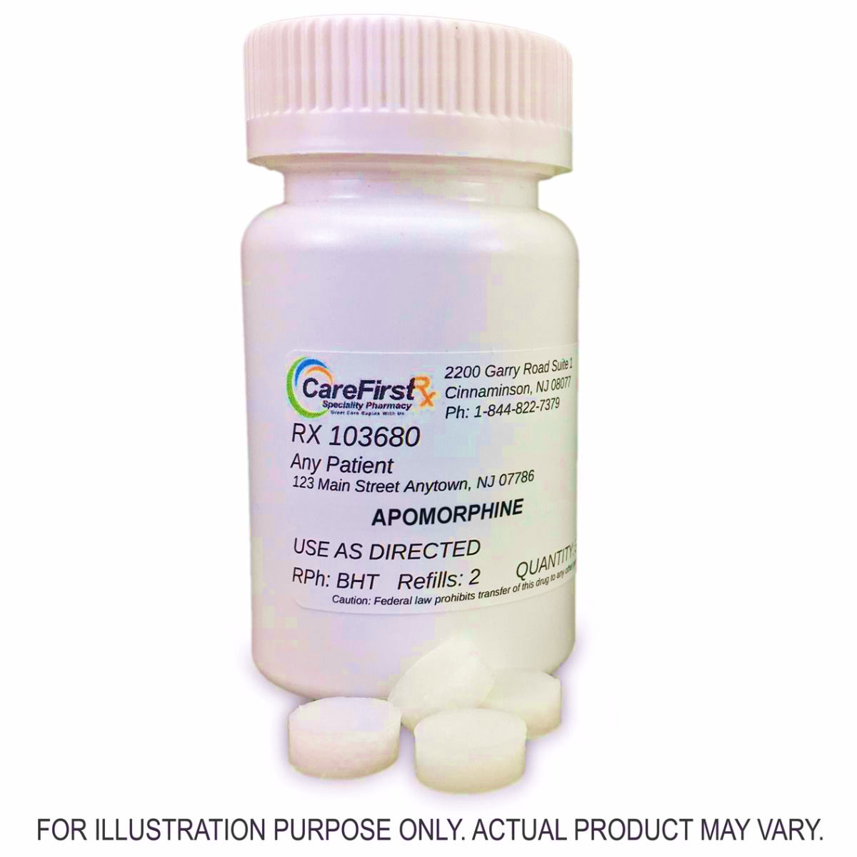
Apomorphine
Administered in the lower eye lid (subconjunctiva)
Requires water/saline flush to stop the vomiting
Compounded
Notes:
Salt / no salt

Slide 35
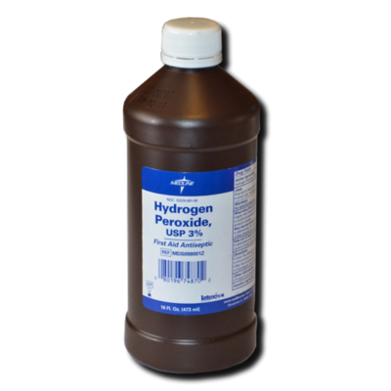
3% Hydrogen Peroxide (H202)
Fresh, bubbling, not expired
1ml H202 / lb dog:
1 teaspoon (5ml) per 5 lbs
1 tablespoon (15mL) per 15lbs
Max Single Dose: 3 Tablespoons (45mL)
If unsuccessful 2nd Dose after 15 min
Notes:
mixing the peroxide in a bowl maybe with a little bit of peanut butter or plain vanilla ice cream. If it's a pet that is getting 3 tablespoons sometimes I will recommend 1 tablespoon of the peanut butter or the plain vanilla ice cream. Basically if you put the treat in a bowl and then put the peroxide with it, especially peanut butter dogs will just continue licking up the peanut butter in the bowl and in the process they will lick up all that peroxide.
Hydrogen peroxide causes vomiting through mild gastric irritation.
Allow light movement (ie. Similar to pacing when you feel sick)
Vomiting usually occurs within minutes ?? Add to bowl with ~ 1 tablespoon lickable treat:
peanut butter, vanilla ice cream etc

Slide 36
Also, Activated charcoal
1.5 grams/kg PO
Initial Dose: Activated charcoal WITH sorbitol as a cathartic
Second Dose (4-6hrs later): WITHOUT sorbitol

Slide 38
Just like human patients…
Smoke Inhalation
Oxygen
HBOT
Cyanide Antidote: hydroxocobalamin only!
Eye Exposure
Flush with Normal Saline (0.9% Sodium Chloride)
10 mL IV Flushes are easy to carry in kit
Tear gas
Different than Humans!
Notes:
http://www.policek9.com/html/oc.html
http://en.wikipedia.org/wiki/CS_gas
CS has a limited effect on animals due to "under-developed tear-ducts and protection by fur". One of CS gasses main effects is excessive tearing. Dogs are limited in their ability to create tears. Pepper spray causes inflammation; it works regardless.

Slide 39
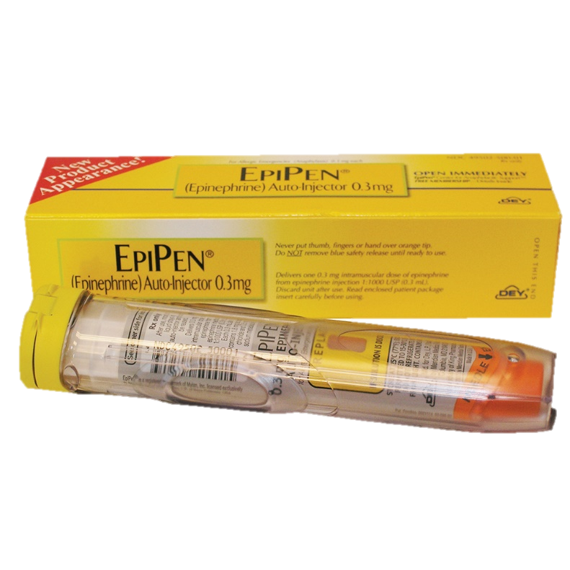
Anaphylaxis
Anaphylaxis:
Potentially immediate life threat
Less common than humans
Multiple systems affected, resulting in shock
Prescribed EpiPen Jr. for severe known allergies
Rare, requires DVM Rx
Plus, H1 and H2 (see Allergic Reactions…)
Notes:
Jr=up to 80lbs

Slide 40
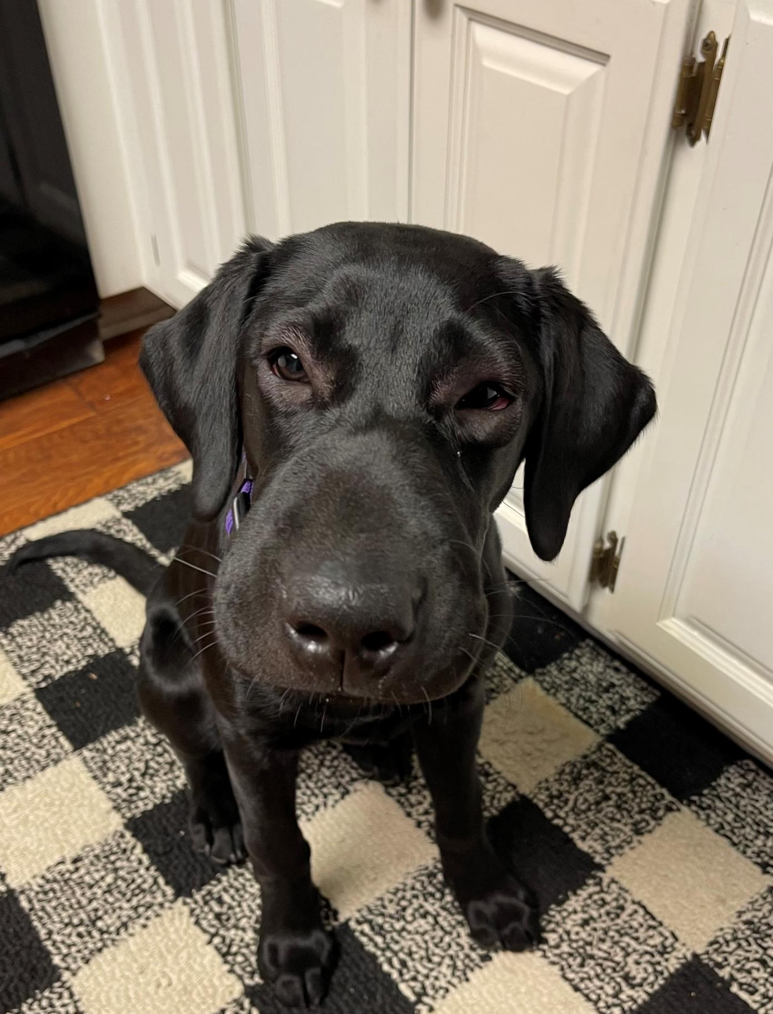
Allergic Reactions
Allergic Reactions
Common
Affected systems: mostly GI/Skin
Facial Swelling
Hives
Bloody diarhea
Ex: K9 Storm after eating bee (aka Spicy Flying Jalapenos)
Notes:
Jr=up to 80lbs

Slide 41
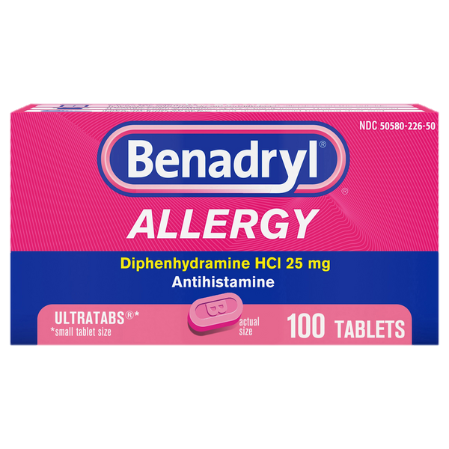
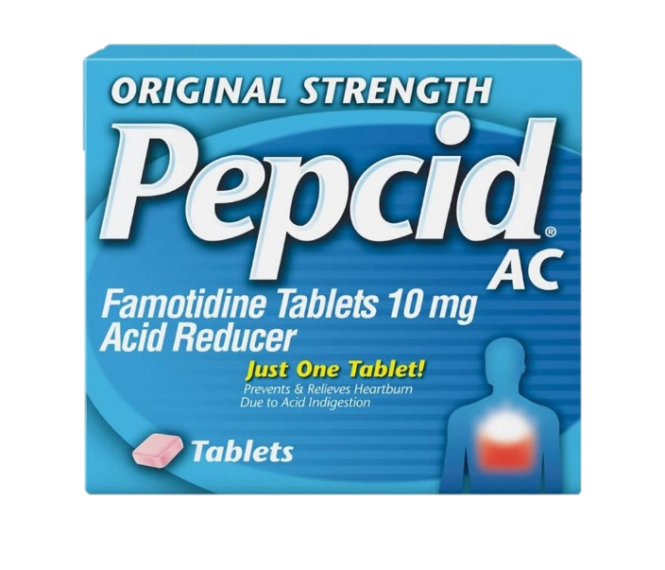
Allergic Reactions
Consider Combination of H1 and H2:
Diphenhydramine (Benadryl™) 2-4 mg/kg Ex 60lb/27kg dog x2-4 25mg tablets
Famotidine (Pepcid AC™) 0.5-1 mg/kg Ex 60lb/27kg dog 3x 10mg tablets
For example: administered after witnessed bee sting and removal of stinger with scraping motion
Notes:
Jr=up to 80lbs

Slide 42
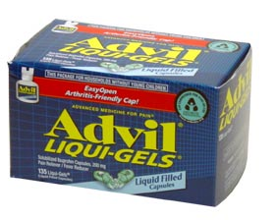
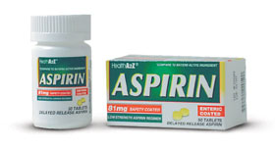
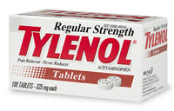
Emergency Pain Management
X
Do NOT use: Ibuprofen / Aspirin
Causes stomach ulceration with single use
Washout period limit subsequent pain meds that can be used
Tylenol?
Discuss with your vet
Best Choice:
Pain Management Prescribed by K9’s Veterinarian for acute pain including shock (Homework!)
Notes:
*Tylenol 15mgs/kg – Plumb
Don’t use IB except under direct DVM care – therapeutic/toxic doses are too close – gastic ulcer – even if not seen.
325MG for regular tylenol and aspirin

Slide 43
Naloxone / Narcan®

Slide 44
Are environmental opioid overdoses common for K9s?
No: Most cases symptoms inconsistent with opioid
Ex racing heart, rapid breathing, jitters etc….
Dogs require higher doses of opioids than humans
But… could happen, so make sure you are ready!
Visually inspect areas prior to deployment when possible
Notes:
True for Human and K9 reported cases
Contoms has a lot of good information and advocacy on this topic.

Slide 45
What are Opioids?
Poppy extracts incl:
Opium
Morphine
Codeine
Heroin
Synthetic alternatives incl:
Hydrocodone
Oxycodone
Oxymorphone
Methadone
Fentanyl
Carfentanyl
Notes:
Historically the definition of opioids including only synthetic and opidates referred to natural.
Today, opioids tend to refer to either natura or synthetic. Hydrocodone (e.g., Vicodin)
Oxycodone (e.g., Oxycontin)
Oxymorphone (e.g., Opana)
Meperidine (e.g., Demerol)
Methadone (e.g., Dolophine)
Fentanyl (e.g., Ultiva, Sublimaze, Duragesic patch)
Carfentanyl (Veterinary) Wildnil, for veterinary use)

Slide 46
What is Naloxone?
Temporarily (~15min) reverses the effects of Opioids
Same dose as humans: 0.04 mg/kg IV, IM, IN, SQ
Notes:
Stronger affinity to the opioid receptors than opioids like heroin so it knocks the opioids off the receptors for a short time and reverses the overdose.
Temporarily (15min)

Slide 47
What is Narcan®?
Brand name version of Naloxone
Notes:
Stronger affinity to the opioid receptors than opioids like heroin so it knocks the opioids off the receptors for a short time and reverses the overdose.

Slide 48
Different meanings: “Narcotic”
“Narcotics” Dog
Reversed by Narcan
Marijuana(?)
Heroine
Cocaine
Morphine/Codeine…
Methamphetamines
LSD
Fentanyl
Carfentanyl
Marijuana
Heroine
Cocaine
Morphine/Codeine…
Methamphetamines
LSD
Fentanyl
Carfentanyl
Notes:
The question mark on marijuana is because we realize that in several states marijuana is being legalized and not all dogs are training on marijuana anymore.

Slide 49
Opioid Symptoms
Lethargy, walking “drunk”
Pinpoint pupils
Severe sedation
Slowed respiratory rate ➡️ ➡️ ➡️ respiratory arrest
Slowed heart rate
Coma
Death
Reminder: “OOOOpioids SLOOOOW You Down”
Notes:
Walking drunk
Vomiting
Pinpoint pupils (dogs)
Dilated pupils (cats)
Severe sedation
Slowed respiratory rate
Slowed heart rate
Coma
Respiratory arrest (stopped breathing)

Slide 50
When do I provide Naloxone?
DO:
If symptoms consistent with opioids (slowing)
Very lethargic and will not resist administration
Otherwise not necessary
DON’T
Give early or just in case
Could wear off before required
Practice with water
Training scar since not sedated/lethargic
Reminder: “OOOOpioids SLOOOOW You Down”

Slide 51
But First… PPE
If a dog IS affected, significant risk to human likely
Protective Barriers
Gloves
Sheets/clothing to cover fur
O2 mask (no mouth to snout)
P100 Mask if aerosolized
Notes:
The first responder exposure to contaminating powder on dog fur during intranasal and intramuscular naloxone administration
Jennifer L. Essler PhD, Paige G. Smith, Carrie E. Ruge BS, Tracy A. Darling RVT, VTS-IM, Ciara A. Barr VMD, DACVA, Cynthia M. Otto DVM, PhD, DACVECC, DACVSMR
https://onlinelibrary.wiley.com/doi/epdf/10.1111/vec.13113

Slide 52
But First… Decontamination
If a dog IS affected, significant risk to human likely
Decontaminate
Cold water
No rubbing alcohol
Notes:
The first responder exposure to contaminating powder on dog fur during intranasal and intramuscular naloxone administration
Jennifer L. Essler PhD, Paige G. Smith, Carrie E. Ruge BS, Tracy A. Darling RVT, VTS-IM, Ciara A. Barr VMD, DACVA, Cynthia M. Otto DVM, PhD, DACVECC, DACVSMR
https://onlinelibrary.wiley.com/doi/epdf/10.1111/vec.13113

Slide 53
Naloxone Admin: Intranasal Narcan®
Preferred
☑️Fastest ☑️Easiest ☑️Smallest
Consider carrying on belt with gloves
Always on you
Temperature control
Designed for human nose, may waste some product
Lower K9 weight means still effective dose

Slide 54
Naloxone Admin: Intranasal ‘MAD’
✅Cheap and effective, even distribution across both nostrils
❌Can be difficult and slow to assemble (https://link.springer.com/article/10.1007/s40122-019-0118-0)
Notes:
MAD: Mucosal Atomizer Device Conclusions
Training nonmedical personnel to use naloxone presents the human factors challenge of how best to design a safe and effective delivery system for lay users given the added mental constraints posed by emergency situations. From a human factors perspective, nonmedical emergency responders and bystanders are more likely to correctly and successfully administer NARCAN® Nasal Spray than a naloxone PFS-NA.

Slide 55
Naloxone Admin: Intramuscular Evzio
Best Landmark AND approach
✅ Effective and fast
❌ Expensive and landmark can be inaccurate
Notes:
Regarding landmark concerns
Make sure thigh muscle approach is caudal/from the tail: different than humans
Otherwise it’s possible to do nerve damage that can require months of rehab

Slide 56
Naloxone Admin: Intramuscular Evzio
Correct Landmarks AND approach NOT Lateral
✅ Effective and fast
❌ Expensive and landmark can be inaccurate
Notes:
Regarding landmark concerns
Make sure thigh muscle approach is caudal/from the tail: different than humans
Otherwise it’s possible to do nerve damage that can require months of rehab

Slide 57
What Next?
Vomit?
 Open muzzle or no muzzle
Dysphoria?  Medical handling
Combative behavior correlates with long-term high-dose users, not our K9s
Symptoms return?
 Monitor and prepare to repeat /15min
Renarcotization

Slide 58
No Naloxone?
Primary risk: Respiratory arrest
Solution: Rescue breaths
Notes:
The first responder exposure to contaminating powder on dog fur during intranasal and intramuscular naloxone administration
Jennifer L. Essler PhD, Paige G. Smith, Carrie E. Ruge BS, Tracy A. Darling RVT, VTS-IM, Ciara A. Barr VMD, DACVA, Cynthia M. Otto DVM, PhD, DACVECC, DACVSMR
https://onlinelibrary.wiley.com/doi/epdf/10.1111/vec.13113

Slide 59
Will Naloxone affect scent ability?
No: See Dr. Cindy Otto research
Dogs return to work next day (if no other injuries)

Slide 60
Snake Bites

Slide 61
US Rattlesnakes
Notes:
http://www.calpoison.com/public/snakebite.html

Slide 62
Russell Viper

Slide 63
Identification
Avoid all snakes
Identification can increase bite risk
Powerful body and thin neck
Triangular or arrow shaped head
Rattle, but not always
Hooded eyes, oval pupils
Snake's color or pattern is NOT reliable ID method

Slide 64
Situational Profile
Curiosity
Entertainment
Unaware
Defense
http://thepetwiki.com

Slide 65
Snake Bite Factors
Bite Motivation
Age
Threat level
Health
Bite Toxicity Stats
25% dry
30% local symptoms only
40% severe
5% fatal
Notes:
Severe = system

Slide 66
Snake Bite Factors
Venom:
Designed to immobilize and predigest prey
Soup of 50+ toxins, unique to each snake
Including blood, neurologic, respiratory and cardiac systems
Location of bite
Airway constriction
Notes:
Severe = system

Slide 67
Vaccination?
To Vaccinate or Not to Vaccinate …
…That is the Question

Slide 68
Rattlesnake Vaccine
Made with Venom from: Western Diamondback
May also cross protect against:
Prairie, Great Basin, Northern and Southern Pacific Rattlesnakes, Sidewinder, Timber Rattlesnake, Massasauga and Copperhead
Partial: Eastern Diamondback Rattlesnake
NO Protection: Water Moccasin (Cottonmouth), Mojave Rattlesnake or Coral
Notes:
Should my dog be vaccinated?
What types of snakes does this vaccine protect against?
How well does this vaccine work?
How long does protection last? How often should my dog be vaccinated?
How safe is this vaccine? Are there any side effects?
What should I do if my vaccinated dog is bitten by a rattlesnake?
Can dogs who have already been bitten by a rattlesnake be vaccinated?
How old should a puppy be before being vaccinated? Can elderly dogs be vaccinated?
Can I use this vaccine for my cat?
Can I use this vaccine for my horse?
Where can I get the vaccine?
How much does the vaccine cost?
Should my dog be vaccinated?
If your dog lives, works or plays where rattlesnakes live, you should consider vaccination with a rattlesnake vaccine. Approximately 300,000 dogs and cats are bitten by venomous snakes each year in the United States. Rattlesnake venom can cause serious injury and even death.
What types of snakes does this vaccine protect against?
This rattlesnake vaccine was developed to protect against Western Diamondback Rattlesnake venom. It is most effective against this snake's venom.
Venom from many other snakes found throughout the United States is similar to the venom of the Western Diamondback Rattlesnake. Because of these similarities, this vaccine also provides protection against the venoms of the Western Rattlesnake (including the Prairie, Great Basin, Northern and Southern Pacific Rattlesnakes), Sidewinder, Timber Rattlesnake, Massasauga and the Copperhead. This vaccine provides partial protection against the Eastern Diamondback Rattlesnake.
This vaccine does not provide protection against the Water Moccasin (Cottonmouth), Mojave Rattlesnake or Coral Snakes. Red Rock Biologics is developing a variety of vaccines to provide the best protection against poisonous snakes for dogs in each part of the country.
How well does this vaccine work?
This vaccine works extremely well at getting dogs to generate protective antibody against rattlesnake venom. These protective antibodies start neutralizing venom immediately. This means that vaccinated dogs experience less pain and have a reduced risk of permanent injury from rattlesnake bite. Veterinarians typically report that such dogs experience less swelling, less tissue damage and a faster recovery from snakebite than unvaccinated dogs.
Factors which may influence antibody effectiveness against venomous snakebite include: the type of snake, location of bite and amount of venom injected; how well the dog has responded to the vaccine and the length of time since the last dose of vaccine was given to the dog.
How long does protection last? How often should my dog be vaccinated?
The maximum protection generated by vaccination typically becomes available about four to six weeks after the most recent vaccine booster dose. That protection then declines slowly over time. Vaccinated dogs typically receive good protection for about six months after boostering. Depending on the dog, some protection may continue out to a year, or longer.
The first time your dog is vaccinated, we recommend an initial vaccine injection followed by a booster dose about one month later. The recommended subsequent boostering schedule of one, two or three vaccine doses per year depends upon your dog's anticipated exposure to rattlesnakes and the size of your dog.
Most dogs that are exposed to rattlesnakes for less than six months per year will only require a single booster dose for that year. The best time to give that dose is approximately one month before the start of the rattlesnake "season." This category includes dogs who live in roughly the northern half of the United States, or dogs who briefly visit locations where rattlesnakes may be active -- such as during a camping or hunting trip.
If your dog will be in an area where rattlesnakes are active for more than six months per year (roughly the southern half of the United States) we recommend two annual booster doses given four to six months apart. Again, the first booster dose should be given one month before the rattlesnake season begins. The second dose is given approximately half-way through the season.
If your dog is at particular risk of being bitten by a rattlesnake (for example, a search and rescue dog, some hunting dogs or dogs living in a high density rattlesnake area), you should consider using three booster doses per year at four month intervals.
Since resistance to venom depends upon the amount of venom neutralizing antibody available, small dogs (under 25 pounds) are at increased risk of envenomation injury. Because of this, a third dose in the initial sequence, and in subsequent years more frequent boosters (e.g. every four to six months), may be advisable in small dogs to maximize their antibody production for more protection.
Large dogs (over 100 pounds) do not develop as high an antibody level as intermediate-sized dogs in response to the two dose initial sequence. For this reason, large dogs may also benefit from a third dose in the initial sequence, although they do not necessarily require additional annual booster doses to maintain that antibody level.
How safe is this vaccine? Are there any side effects?
Safety data for this vaccine is similar to the available safety data of other pet vaccines currently in use. The vaccine is licensed by the United States Department of Agriculture and is recommended by thousands of veterinarians nationwide. The vaccine is safe for use in pregnant and lactating dogs, puppies as young as four months and healthy older dogs.
Side effects reported by veterinarians have been few and mild. Less than one percent of vaccinations result in a mild swelling at the injection site. The swelling does not bother the dog (there is no itching or pain) and the swelling resolves without treatment in about three weeks. Occasionally, a veterinarian may drain fluid from the swelling or prescribe antibiotics to speed up healing. Rarely (less than one-tenth of one percent of vaccinations), dogs have experienced mild cases of vomiting, diarrhea or lethargy for one to two days after vaccination. Cases of life-threatening anaphylaxis (an acute, "allergic" reaction to the vaccine) are extremely rare with this vaccine. These are estimated to occur at between one and three cases per million doses of vaccine administered.
A decision to vaccinate your dog should balance the risk and consequence of a venomous snakebite with the risk and consequence of vaccination. We recommend that you talk with your veterinarian about these risks.
What should I do if my vaccinated dog is bitten by a rattlesnake?
Snakebite is always an emergency. Even a vaccinated dog should be taken to a veterinarian for evaluation and care as soon as possible following snakebite. Veterinarians can determine if your dog's immunity at the time of the bite is sufficient for the venom dose received or if additional treatment is required. Even bites by non-venomous snakes can lead to serious infections and antibiotic treatment may be needed. A veterinarian is the best person to consult regarding medical decisions for your dog.
Can dogs who have already been bitten by a rattlesnake be vaccinated?
Yes. We recommend waiting six weeks after your dog has been bitten by a rattlesnake before vaccination with this product. This wait will allow your dog to fully recover from the snakebite and will reduce the possibility of unfavorable interactions between the vaccine and any residual venom.
How old should a puppy be before being vaccinated? Can elderly dogs be vaccinated?
There have been no reports of any age-related adverse effects due to this vaccine in healthy dogs vaccinated as young as four months or in elderly dogs. Because we do not have any information on the vaccination of puppies that are younger than four months we do not recommend vaccination of puppies in this age group. Regardless of age, the vaccine should only be administered to healthy dogs.
Can I use this vaccine for my cat?
Our research suggests that the rattlesnake vaccine may actually work better in cats than in dogs. However, since the vaccine is not specifically licensed for use in cats, a veterinarian must determine if it can be administered to your cat. If you think your cat is likely to encounter rattlesnakes, discuss the potential risks and benefits of the vaccine with your veterinarian.
Can I use this vaccine for my horse?
This vaccine was not formulated for horses and we do not have any data supporting the use of this vaccine in horses. We are currently developing a modified version of the rattlesnake vaccine for horses.
Where can I get the vaccine?
The vaccine is only available through veterinarians. Your regular veterinarian knows your dog's health history, and is the best person to call to obtain the vaccine for your dog.
How much does the vaccine cost?
Veterinarians set their own price for administering the vaccine.
back to top

Slide 69
What We Know about this Vaccine
Only one third party research paper
Anecdotal only:
Safety: similar safety to other vaccines
Efficacy: minimize initial onset of pain, reduce swelling, and ultimately reduce tissue damage
May provide a buffer of time to reach veterinarian
Less anti-venom may be required
Notes:
Canine Rattlesnake Vaccine 11/09 guidelines - The canine rattlesnake vaccine comprises venom components from Crotalus atrox (western diamondback). Although a rattlesnake vaccine may be potentially useful for dogs that frequently encounter rattlesnakes, currently we are unable to recommend this vaccine because of insufficient information regarding the efficacy of the vaccine in dogs. Dogs develop neutralizing antibody titers to C. atrox venom, and may also develop antibody titers to components of other rattlesnake venoms, but research in this area is ongoing. Owners of vaccinated dogs must still seek veterinary care immediately in the event of a bite, because 1) the type of snake is often unknown; 2) antibody titers may be overwhelmed in the face of severe envenomation, and 3) an individual dog may lack sufficient protection depending on its response to the vaccine and the time elapsed since vaccination. According to the manufacturer, to date, rare vaccinated dogs have died following a bite when there were substantial delays (12-24 hours) in seeking treatment. Recommendations for booster vaccination are still under development, but it appears that adequate titers do not persist beyond one year after vaccination. Adverse reactions appear to be low and consistent with those resulting from vaccination with other products available on the market. The product license is currently conditional as efficacy and potency have not been fully demonstrated. Based on existing evidence, the UC Davis VMTH does not currently recommend routine vaccination of dogs for rattlesnake envenomation, and the vaccine is not stocked by our pharmacy.
AAHA 2011: Does not state recommend NOR not recommended.

Slide 70
Vaccination
How often?
Maximum protection four to six weeks
Declines slowly over time
1-3 doses per year
Remains Emergency!

Slide 71
Physical
Snake Fences
Avoid known areas

Slide 72
Avoidance training
Applying adverse stimulus to produce a desired result
Shock/other dog collars to avoid sight, scent AND sound of rattlesnakes
Consider
Number of senses/scenarios provided
Severity/calibration of stimulus
Decision points of K9

Slide 73
Field Treatment
*Key* Responses

Slide 74
Snake Bite Treatments
Most Important…

Slide 75
Snake Bite Treatments
Most Important…

Slide 76
Snake Bite Treatments
Next Most Important…

Slide 77
Snake Bite Treatments
Next Most Important…

Slide 78
How About ???
Nope
Extraction Kits?
Ice??
Cut and Suck Method??
Tourniquet??

Slide 79
Calm Transport
Reduced physical exertion slows spread of toxins
Can you lift your dog?
How far could you carry?
One or two people?
Would your dog remain calm?
Practice!

Slide 80
Advance Planning
Where’s the Closest Anti-venom?
All geographies
All hours
In-stock
In-date
Types?

Slide 81
Treatment
All bites considered an emergency
Time is of the essence for treatment
Digestion starts immediately
Once started even antivenin can’t stop process
Even dry/mild cases hospitalized 8+ hrs
Delayed symptoms can occur

Slide 82
Treatment
Supportive care and monitoring
Many affected organ systems
Important to monitor functions and treat accordingly
Fluids
Pain control
System support
Steroid use associated with increased morbidity

Slide 83
Treatment
Benadryl™ (Diphenhydramine)?
NO action of mitigation against snake bites
MAY be beneficial with regards to antivenom reaction (at Veterinarian’s discretion)
MAY calm patient?
NEVER delay transport/treatment to acquire Benadryl™

Slide 84
Hyperbaric Oxygen Therapy
Less Tissue Damage
Faster Healing

Slide 85
Monitoring
Objective Snakebite Severity Score
Pulmonary System
Cardiovascular System
Local Wound
Gastrointestinal System
Hematological System
Central Nervous System

Slide 86
Antivenin
Neutralizing antibody helps neutralize toxin
Does not help existing damage
Used in moderate to severe cases

Slide 87
Antivenin Not All are Created Equal
BI Product | Crofab | Mexican Product | Argentinian Product
Only US licensed veterinary product | Human product | Experimental | Clinical Trial
Whole Equine Protein | Fragmented Ovine Protein | Fragmented Equine Protein | Fragmented Equine Protein
More potential for reactions | Less potential for reactions | Less potential for reactions | Less potential for reactions
Western and Eastern Diamondback, Fer-de-Lance and South American Rattlesnake | Western and Eastern Diamondback, Mojave, Water Moccasin | South American Rattlesnake and Fer-de-Lance | South American Rattlesnake, Fer-de-Lance, Bushmaster
$$ | $$$$ | $$$ | Free Clinical Trial

Slide 88
Prognosis
Survival Rates for those dogs that receive antivenin is 72-83%

Slide 89
PharmaCOLOGY

Slide 90
TXA – Tranexemic Acid
INDICATIONS
Hemorrhagic shock
Head injury
DOSE:
0.5 gram slow IV push
ASAP but NOT later than 3 hours after injury
Notes:
Hemorrhagic shock
amputation, penetrating torso or abdominal trauma, or evidence of severe bleeding)
May 2023 K9TCCC update changed to 0.5 gram

Slide 91
Blood Products: Order of Preference
K9 whole blood
K9 plasma and K9 pRBCs in a 1:1 ratio,
Or (second unit may be required)
Reconstituted lyophilized K9 plasma
K9 liquid plasma
Thawed K9 fresh frozen plasma alone
K9 pRBCs alone

Slide 92
Blood Products
End goals:
Palpable femoral pulse, improved mental status or
Systolic BP 100-110 mmHg
1g of calcium chloride IV/IO after the second transfused product
ASAP but not later than 72 hours prior to injury, (unless veterinarian approved)

Slide 93
If no blood, then crystalloids
End goals:
Palpable femoral pulse
Improved mental status
Systolic BP 100-110 mmHg

Slide 94
Analgesia Sedation Goals:
Reduce pain while protecting airway and mentation (monitor ABCs)
Sedation/chemical restraint to stop awareness of painful procedures
Notes:
Head injury and/or non-penetrating eye injury does not preclude the use of ketamine in K9s at the K9TCCC recommended doses. Use caution with IV/IO ketamine, or midazolam in a head injury as this makes it difficult to perform a neurological exam or determine if the casualty is decompensating. •

Slide 95
Analgesia / Sedation Notes
Opioid doses for higher than humans
Opioids often cause vomiting
Hydromorphone causes panting; caution with head injuries and respiratory disease.
Polypharmacy is recommended in K9s…
Notes:
https://vetmeds.org/pet-poison-control-list/morphine/#!form/PPCDonations
Head injury and/or non-penetrating eye injury does not preclude the use of ketamine in K9s at the K9TCCC recommended doses. Use caution with IV/IO ketamine, or midazolam in a head injury as this makes it difficult to perform a neurological exam or determine if the casualty is decompensating.
DO NOT administer Oral Transmucosal Fentanyl Citrate (OFTC) to a K9 orally or per rectum. The sole use of routine benzodiazepines such as midazolam is NOT recommended for analgesia
If a K9 appears to be partially dissociated, it is more efficacious to administer more ketamine than to administer more benzodiazepine.

Slide 96
Mild Pain
Morphine at 0.25-0.5mg/kg IM (one 10mg morphine autoinjector)
Hydromorphone 0.1 mg/kg IV/IO/IM
Fentanyl (injectable) every 20-30 minutes at 2-5mcg/kg IV/IO, 10mcg/kg IM
Ketamine (50mg) IV/IM/IO + Midazolam (10mg) IV/IO/IM
Notes:
Opioids (if the K9 is not fractious, an opioid may be all that is needed)

Slide 97
Moderate to Severe Pain
Ketamine (50mg) IV/IM/IO + Opioid
Morphine at 0.25-0.5 mg/kg IM
Hydromorphone 0.1 mg/kg IV/IO/IM
Fentanyl (injectable) every 20-30 min at 2-5 mcg/kg IV/IO or 10 mcg/kg IM

Slide 98
Moderate to Severe Pain
Ketamine (50mg) IV/IM/IO + Midazolam (10mg) IV/IO/IM + Opioid:
Morphine at 0.25-0.5 mg/kg IM
Hydromorphone 0.1 mg/kg IV/IO/IM
Fentanyl (injectable) every 20-30 minutes at 2-5 mcg/kg IV/IO or 10 mcg/kg IM

Slide 99
Chemical Restraint/ Sedation
Ketamine (100 mg) IV/IM/IO + Midazolam (10mg) IV/IO/IM
Ketamine (100 mg) IV/IM/IO + Opioid:
Morphine at 0.25-05 mg/kg IM
Hydromorphone 0.1mg/kg IV/IO/IM
Fentanyl (injectable) every 20-30 minutes at 2-5 mcg/kg IV/IO or 10 mcg/kg IM

Slide 100
Drug Reversals
Naloxone (Narcan®): 2mg IV/IO or 4mg IM/IN Repeat as needed
Flumazenil (Romazicon®) 0.02mg/kg IV/IO; repeat every 30 - 60 min as needed 0.5 mg

Slide 101
Antibiotics
Recommended for all open combat wounds
If able to take PO meds consider: Moxifloxacin 400mg PO once a day
Ceftriaxone 25mg/kg IV/IM every 12 hours
Cefotaxime 25mg/kg IV/IM every 8 hours
Ertapenem 15-30 mg/kg IV/SC every 8 hours

Slide 102
Head Injuries
Head Injuries:
150ml of 3 or 5% hypertonic saline IV/IO bolus over 2-5 minutes

Slide 103
Motion Sickness
Maropitant (Cerenia)
For Prevention of Vomiting due to motion sickness : minimum dose of 8 mg/kg (3.6 mg/lb) Q24 hr for up to 2 consecutive days
Does not cause sedation
Veterinary labeled product
Notes:
https://www.zoetisus.com/content/_assets/docs/vmips/package-inserts/cerenia_tablets.pdf

Slide 104
Motion Sickness
Promethazine (Phenergan)
0.2-0.5 mg/kg PO Q 6-8 hr; oral bioavailability is low (~10%), can be given IM
Avoid in hypovolemia/shock
Adverse effects – sedation
Human product
Notes:
https://www.dvm360.com/view/antiemetic-therapy-dogs-and-cats-new-versus-old-proceedings

Slide 105
Burn Injuries

Slide 106
BURNS
Facial burns:
Monitor airway status and oxygen saturation
Consider early intubation or surgical airway for respiratory distress or oxygen desaturation
Dog/Human Difference:
Fur may hide burn tissue

Slide 107
Total body surface area (TBSA)
Calculate to the nearest 10%
Notes:
using the published chart (Henriksson A, et al. 2022) for estimating canine body surface area, similar to human Rule of Nines

Slide 108
Total body surface area (TBSA)
Card method Similar to palmar method 1.5% of 65lb/30kg dog
Notes:
using the published chart (Henriksson A, et al. 2022) for estimating canine body surface area, similar to human Rule of Nines

Slide 109
If TBSA >20%
Initiate IV/IO fluid rate as %TBSA x 10 ml/hr (hemorrhagic shock dose takes precedence if applicable)
Consider heat reflective shell / Blizzard
Also, See Pain Meds
Notes:
in order to both cover the burned areas and prevent hypothermia

Slide 110
Hypothermia
Remove/protect from cold ground/air
Dry fur
Snow works as sponge
Keep fur dry as long as operationally possible if overnight

Slide 111
Hypothermia
Heat sources
Warm liquids (if able to swallow)
Jello (no xylitol)
Soup (no salt, onion, garlic)
Water bottles, heating packs, etc

Slide 112
Questions?
Woof@K9MEDIC.com
www.Facebook.com/K9MEDIC
1-855-4K9-MEDIC
Evals
Certs via Online Portal (2 weeks)

Slide 114
For K9 Handlers – Basic Scope
Vehicle/Station Based:
Immediate Access:
Within 5 minutes
Additional life saving
Everyday first aid
Small to Medium Duffle bag size
Within seconds
Immediate life saving
Small enough to fit in cargo pocket or belt mount

Slide 115
The “Oh $H!+T” Kit
Accessible within seconds!
Ability to treat immediate life threats for Handler and their K9

Slide 116
You:
You and Your K9:
Your K9:

Slide 117
Other to Add:
NarCan Kit with belt pouch
Emergency medical blanket

Slide 118
The BackUp / Base Bag
Accessible within minutes!
Additional life saving treatments for multiple patients
Ability to provide commonly required first aid interventions
Solution Based User Interface is best!

Slide 119
Base Bag
Ouch Pouch
Heat and Hydration
1x 30cc Flushing Syringe
2x 4"x4" Nonstick bandage
4x 2"x2" Square Gauze
4x 4"x4" Square Gauze
1x bandage scissors
1x 1" Medical Tape
1x 2" Elasticon Tape (especially for ear wraps)
3x 3" Conforming Stretch Gauze Roll
2x 2" Vetwrap
2x 4" Vetwrap
2x Large Abdominal Trauma Pad
2x Tegaderm covers (for human use)
1x Sharpie Marker
Consider: "saran" wrap, "Pawz" booties (as fast medical bootie), "NoFlap EarWrap"
Thermometer
Lube
Cold Packs
Water Bottle(s)
Water bowl
Cold
Emergency blanket
Heat packs (handwarmers with adhesive side)

Slide 120
Base Bag
Basic Life Support
Toxins
Oxygen mask
Cage Muzzle
Nasal Canula
MBOT connectors (small zip ties)
Barrett Muzzle when available
Who to Call Sticker/Card (Pet Poison / APCC)
Narcan Pouch with Gloves
Prescription for Apomorphine is best Otherwise Hydrogen Peroxide and Syringe/Doser
Otom Tick Remover (or same L shape)

Slide 121
Base Bag
Medications
Other
Storage for actual meds and prescriptions / dose
Dog's Prescribed Emergency Pain med
Dog's Prescribed daily care meds if needed
Consider Veterinarian prescribed ready care incl
Benadryl
Stomach upset
etc
Full Cage Muzzle (consider Baskerville)
Vitals Baseline Card (www.K9MEDIC.com/resources)
Patients Cards (www.K9MEDIC.com/resources)
Medical Records / Veterinary Contact Info Sheet
Tweezers
Hemostats
Tissue Stapler (confirm scope)
Soft Stretcher: (Direct Action K9)

Slide 122
The Problem with Pain
Acute trauma is very painful
Pain meds
Improve safety for providers
Improve dog comfort
Speeds healing when started early in the pain cascade

Slide 123
Upcoming Classes: www.K9MEDIC.com/events
Sept 5-7 Vegas, NV Sept 26-27 Branford, CT
Oct 3-5 Butts County, GA Dec 19-21 Vegas, NV

Slide 124
Massive Bleeding Skills:
Sign In for Attendance Cert , Eval, and Free Online Airway Course featuring XXT
Event Code: 2308-AZ-HITS
www.K9MEDIC.com/roster

